Slide 1
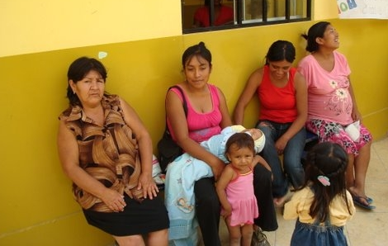
IPPF/WHR – UNFPA/DC
USAID Graduation Policy
Fact-finding Trip
Peru – May 16-22, 2010

Slide 2

Government, Service Providers and Communities

Slide 3
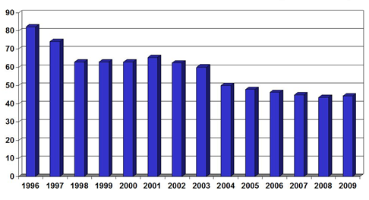
USAID Funding for FP/RH
Latin America and the Caribbean ($millions)
Source: USAID

Slide 4
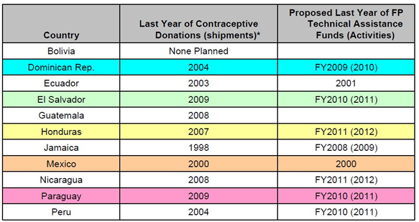
Working List** for Family Planning “Graduation” USAID/LAC Region
*Does not include condoms for HIV programs
**Note that these are planning dates and may be modified

Slide 5
Key USAID Graduation Criteria
total fertility rate of 3.0 or less
modern contraceptive prevalence rate of a minimum of 50% among married women of reproductive age (15-44)
access to at least three different methods of family planning among at least 70% of the population
30% or less of public and private sector FP products, services and programs are funded by USAID
Major service providers (public sector, NGOs, commercial sector) generally meet and maintain standards of informed choice and quality of care

Slide 6
Challenges for Graduation I
Indicators for graduation from USAID support mask wide variations within countries
Funding for FP/SRH depends to a large extent on fiscal conditions, the strength of FP advocacy groups, and shifting policies
National governments face higher prices in contraceptive procurement than donors, largely due to smaller scale purchasing
Decentralization of health services poses further challenges to contraceptive security

Slide 7
Challenges for Graduation II
Most countries not yet graduated and/or slated for upcoming graduation lack a contraceptive security plan post-graduation
Decreased donor funding has forced many non-profit providers to move away from serving the poor towards increased user fees
Free services, largely provided by Ministries of Health, have tended to be poorly targeted and disproportionately benefited the middle to upper classes rather than the poor

Slide 8
Characteristics of LAC Region SRHR
High income inequality
High rate of unsafe abortion
High rate of teen pregnancy
Maternal mortality remains high
Contraceptive security challenges

Slide 9
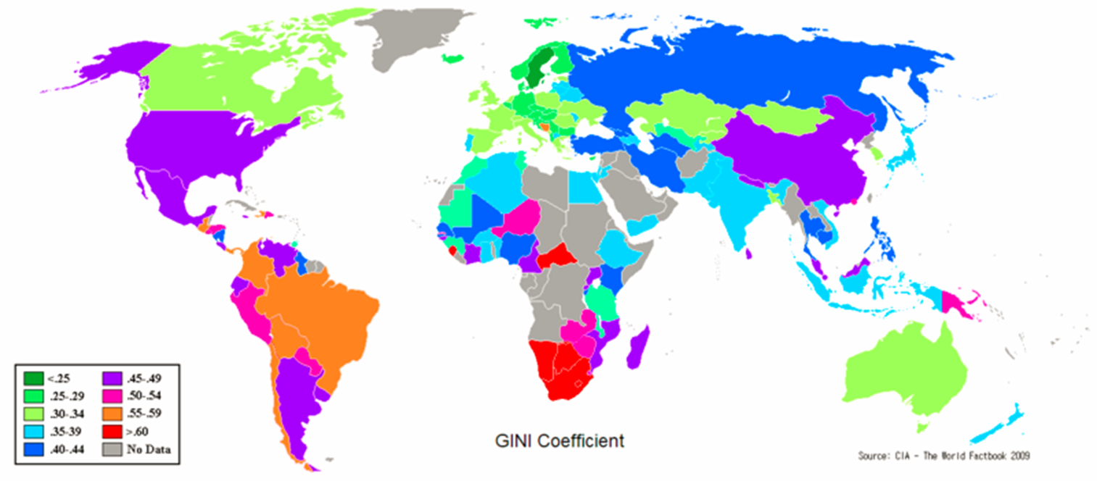
Inequality in Global Comparison
Increase budget to support more donor prospecting
Developing a strategy for Online Fundraising
Completion of the OCR process through our efforts with Euro-American, Bank of America and the Finance department.

Slide 10
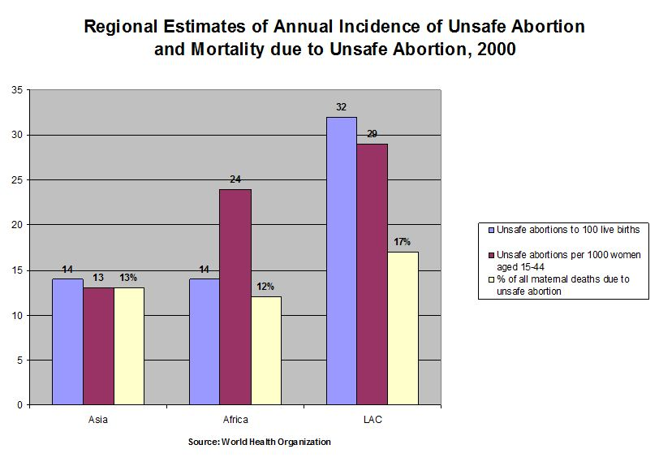

Slide 11
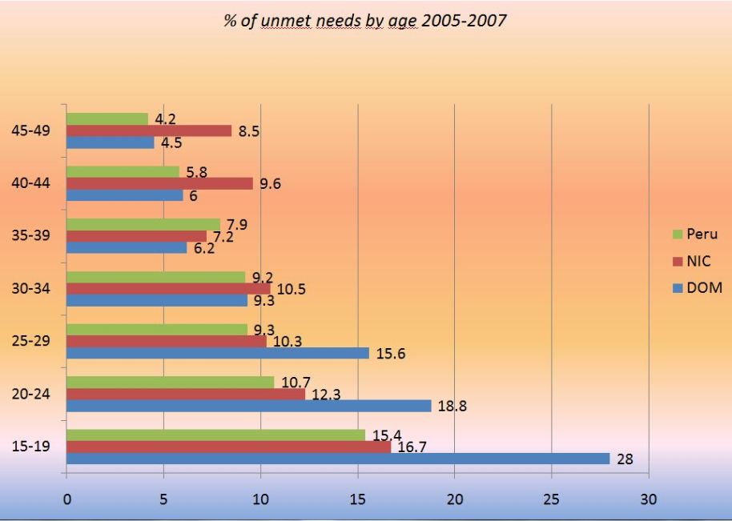

Slide 12
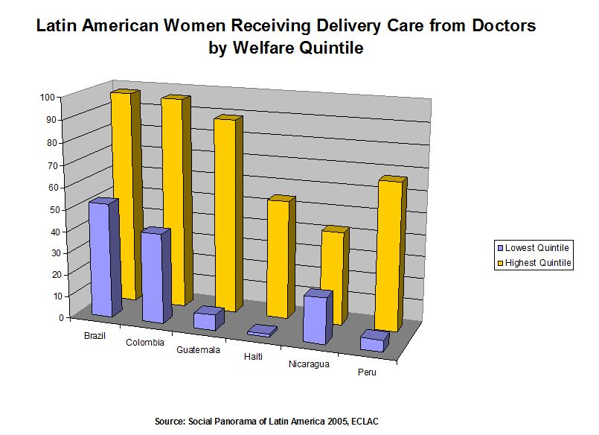

Slide 13
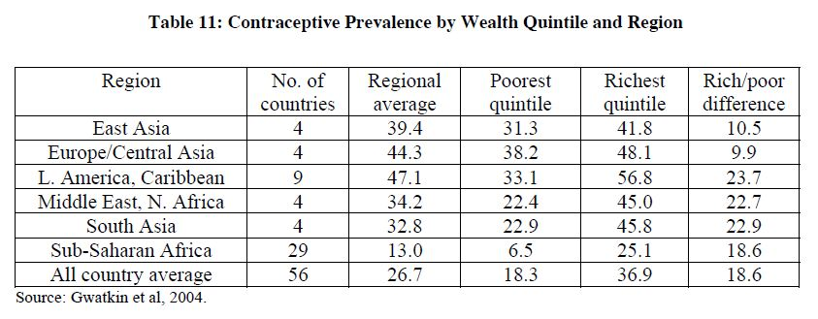

Slide 14
Peru at a Glance
High income inequality
High regional inequality
Urban/Rural inequality

Slide 15
Peru SRHR at a Glance
60% of pregnancies unplanned and/or unwanted
  Contraceptive stock-outs/scarcity
Abortion illegal except under therapeutic circumstances
Second highest rate of maternal mortality in Latin America

Slide 16
Peru SRHR Political/Policy Context
Uneven political support for SRHR over last 20 years
Decentralization of Peru’s health care system

Slide 17
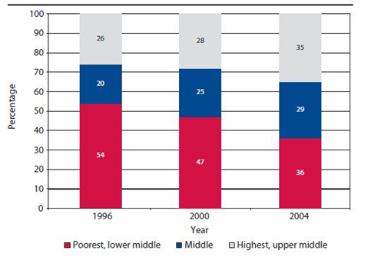
Figure I. Family Planning Client Profiles in Peru’s Ministry of Health, 1996-2004
Source: USAID 2006 (Options for Contraceptive Procurement)

Slide 18
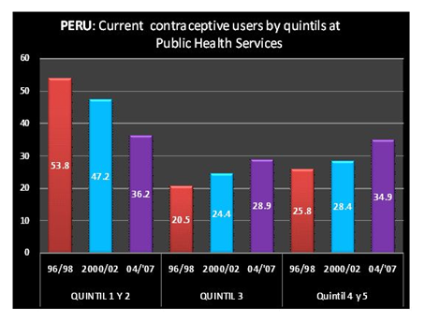

Slide 19
Delegation’s Findings I
Peru -- great progress in addressing its SRH challenges in the last 30 years with USAID as the major donor for SRH/FP
But persistent high inequities in access to FP/SRH services among rural, indigenous and poor populations
Lack of contraceptive security with frequent stock-outs
State governments lack technical capacity, trained staff, or funding necessary to administer health care under health decentralization policies

Slide 20
Delegation’s Findings II
Flawed National insurance plan, in terms of equal access and availability of family planning services
Lack of apparent donor coordination, especially with the Global Fund
High level of teen pregnancy
High level of sexual violence
High level of unsafe abortion

Slide 21
Principal Recommendations
USAID should temporarily suspend its plan to graduate Peru from USAID FP/SRH funding by 2011 and commit to maintain the level of funding currently provided through FY2015.
Conduct an evaluation of the current status of SRH in Peru, which goes well beyond the macro-level indicators currently being used
Develop a new SRH graduation plan for Peru which focuses on considering short term funding increases for Peru, before the US reevaluates phasing out support to help ensure that adequate capacity exists for the government to take on responsibility for the SRH needs of the country.

Slide 22
What Lies Ahead?

