Slide 1
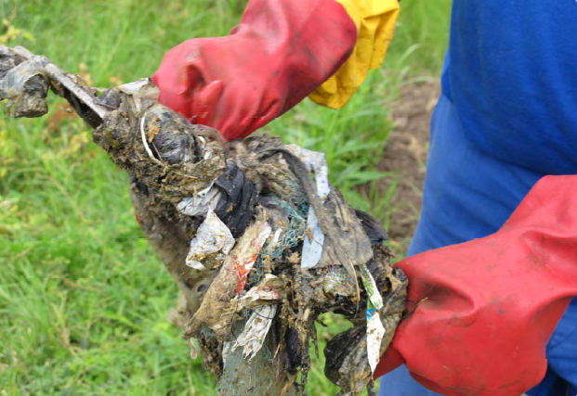
Menstrual products and sanitation systems
Findings of case studies from South Africa and India
Robyn Wilmouth,* MScEng, PMP
Photo credit: PATH
26 April 2022
*Prior employee of PATH who obtained permission to share findings from research conducted during tenure at PATH and under a grant led by Vivian Hoffman at the University of Maryland and provided by the Bill and Melinda Gates Foundation .
Notes:
Cover photo: PATH/Robyn Wilmouth. The photo captures the materials extracted from a pipe connected to a house within the formal settlements constructed under the social housing scheme. Materials included cloth rags and panty liners.

Slide 2
Background
Overall goal of the Menstrual Management and Sanitation Systems (MM&SS) project was to understand to what extent menstrual hygiene management (MHM) should be a consideration when planning sustainable sanitation systems for the urban and peri-urban poor.
Objectives were to understand how MHM practices and products impact promising⁽¹⁾ sanitation systems that serve low-income populations in urban and peri-urban areas and how the systems affect the menstruating women who use them.
(1) Promising defined per guidance provided by the funder’s (Bill and Melinda Gates Foundation) sanitation strategy.
Notes:
Gates Foundation model for sanitation priorities (speech on October 6, 2011, by Frank Rijsberman):
- Priorities include: household-level toilets/latrines, pathogen removal and/or deactivation, resource recovery, minimal water usage, affordable (goal = $0.05 per person per day), onsite sanitation, decentralized sanitation, pour-flush connected to onsite systems, septic tanks, decentralized wastewater systems (DEWATS), dry sanitation, composting systems, “intermediate solutions” include resource recovery at a neighborhood/communal level, etc.
- Priorities do not include: systems connected to sewers (centralized sanitation), low-cost small borehole systems connected to sewers.

Slide 3
Methods
Case studies were conducted with local partners at University of KwaZulu-Natal (UKZN) in eThekwini municipality, Durban, South Africa, and at the Society for Community Organization and People’s Education (SCOPE) in Tiruchirappalli, Tamil Nadu, India.
The case studies were divided into user-focused research with a total of 61 women of reproductive age, and sanitation system–focused research with a total of 77 government and nongovernmental organization (NGO) stakeholders, system operators, and personnel of a range of communal and household sanitation systems in both countries.
Qualitative methods used to gather data were in-depth interviews, focus group discussion, direct observation, photography, and photovoice research.
Notes:
Photovoice is a method whereby users tell their stories qualitatively by photographing their everyday activities. This photovoice research was divided into four phases and involved the following activities: 1) a workshop to orient women to the photovoice activity and provide training in how to take good photographs; 2) photo documentation by the women of their menstrual management practices; 3) follow-up in-depth interviews (IDIs) with a subset of women to review the photos and collect contextual information about their menstrual management practices; and 4) videotaping of users of one to three sanitation systems (for a total of three women) as they took us through their steps in managing their monthly periods. Participants were not asked to use any products other than those they normally use, or make any changes in their behavior during the photovoice, nor did women have to be menstruating when taking pictures.

Slide 4
Key findings
Women in the case study acknowledged the social, cultural, and religious messages and taboos about menstruation being dirty, polluting, and shameful. The acceptance of these age-old perceptions contributes to women continuing to manage menstruation in isolation.
Disposal methods often coincide with taboos—which contribute to women’s decisions to bury, burn, dump, or dispose in the garbage—and underlie the practice of washing of MHPs prior to disposal in some cultures.
The greatest risk to women’s sense of privacy was the discarding of menstrual waste and the potential for it to be seen by others which would bring embarrassment and, for some, shame. Substantial effort is put into the discreet disposal of used products.
“When our bloods are getting spilt there, we will be bitten by shyness.” – MMSS study participant

Slide 5
Key findings (cont.)
Without waste bins in the female restrooms of communal sanitation facilities and educational messages on disposal practices, the increased volume of disposable menstrual waste is likely to cause blockages in piped systems resulting in expense and disuse of sanitation systems.
Women—and facility caretakers, where they exist—must be included early on in the planning process for promising sanitation and waste systems to ensure system appropriateness and use.
Coordination between sanitation and solid waste management systems is essential, as is involvement of women who use the systems, particularly communal systems.

Slide 6
Study’s recommendations – Planning
• As women move from reusable cloth to disposable MHPs, anticipate the impact of increased volumes of disposable menstrual waste on sanitation and solid waste management systems.
• Clarify roles and responsibilities of sanitation and solid waste management departments.
• Develop national guidelines, budgets, information, and tools for appropriate menstrual waste disposal.
• Use a methodology such as a decision-tree to map out the cultural, political, financial, and environmental constraints for acceptable disposal options for MHPs.

Slide 7
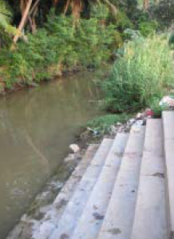
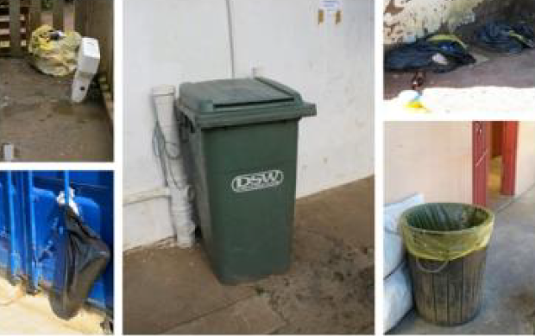
Study’s recommendations – Involving women
• Include women, especially those affected by decisions, in planning for MHPs and waste disposal systems.
• Ensure female planners are available for women to interact with.
Photo credit: PATH

Slide 8
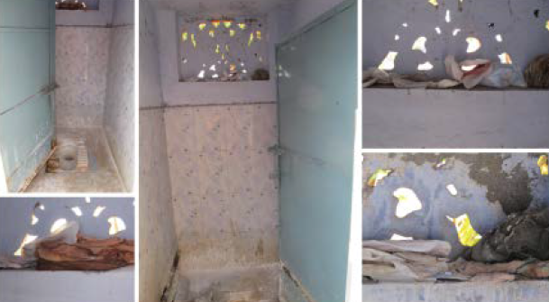
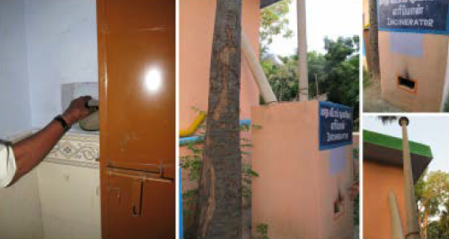
Study’s recommendations – Disposal containers
• Provide accessible, appropriate menstrual waste disposal containers for sanitation facilities, with input from women and facility caretakers.
• Pilot use of dedicated containers for menstrual waste prior to widespread introduction.
Photo credit: PATH

Slide 9
Study’s recommendations – Education and information
• Provide all actors in the menstrual hygiene and sanitation chain from planners to menstruating women with appropriate information regarding menstrual waste and its disposal.
• Seek guidance from women and sanitation workers on dissemination approaches.
• Include health education related to puberty and menstruation for girls and boys in schools or through community groups or peer-to-peer education.

Slide 10
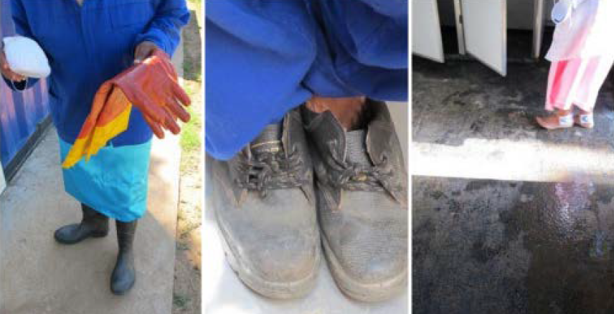
Study’s recommendations – Protect workers
• Provide sanitation and solid waste management workers with appropriate personal protective equipment (i.e., dexterous, appropriately sized gloves) for handling of solid and human waste.
Photo credit: PATH

Slide 11
eThekwini municipality’s pipe blockage teams
Photo credit: PATH

Slide 12
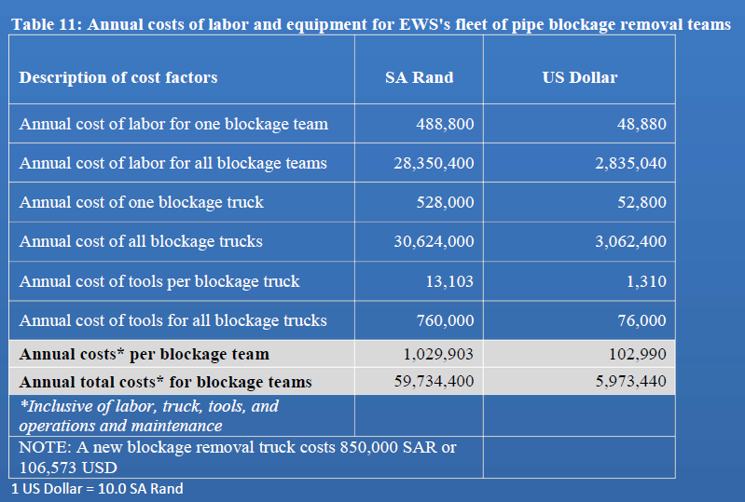
Costs of blockages
eThekwini municipality experienced an annual cost of ~$6 million USD (2013 USD) to maintain a fleet of 58 blockage removal teams
Source: Table 11, Menstrual Management and Sanitations Systems Project, Final Report, 2013, PATH

Slide 13
PATH’s menstrual hygiene product loading model (version 2.0)
Lifetime loading ranged from 0.1 to 190 kg/person/life.
For comparison, 2018 average municipal solid waste disposal rate for United States is 4.9 pounds/person/day⁽¹⁾, which is 2.2kg/person/day.
(1) Source: https://www.epa.gov/facts-and-figures-about-materials-waste-and-recycling/national-overview-facts-and-figures-materials
Model assumed 35 menstruating years for defining “lifetime.”
Source: Table 4, Menstrual Management and Sanitations Systems Project, Final Report, 2013, PATH

Slide 14
Disposal of menstrual products
Culturally appropriate, discrete and safe solid waste management systems:
Increase dignity for menstruating women
Increase safety for formal and informal workers
Increase functionality and longevity of sanitation systems

Slide 15
Acknowledgments
Special thanks to:
Study participants from eThekwini municipality and Muhiri district of Tamil Nadu
Local collaborating partners - eThekwini Water and Sanitation Unit and SCOPE
Research partners and funding agencies
In memory of:
Our research collaborator – Professor Chris Buckley – from University of KwaZulu Natal.
For further inquiry:
LinkedIn: robynwilmouth
Notes:
PATH was a subcontractor to the University of Maryland on this grant funded by the Bill & Melinda Gates Foundation.
PATH acknowledges the contributions and support of Chris Buckley, University of KwaZulu -Natal, Pollution Research Group; Teddy Gounden, eThekwini Water and Sanitation Unit; Jennifer Norins, Innovations for Poverty Action; Fiona Scorgie, qualitative research consultant, Johannesburg, South Africa; MatCH, Durban, South Africa; Thokozile Phiri, research assistant in Durban, South Africa; Mr. Subburaman, Society for Community Organization and People’s Education (SCOPE), Musiri, Tamil Nadu; and Market Vitamins, Chennai, Tamil Nadu, India. We would also like to acknowledge the contributions of our graduate student interns—Carley Truyens and Laura Hoppenjans. We are grateful for the contributions of the many sanitation system personnel, general stakeholders, caretakers, and women who contributed to our understanding of menstrual hygiene and sanitation systems.

