Slide 1

Advocacy Deck

Slide 2
Contents
Purpose
Trends
  Funding Trends
  Condom Use Trends
  Major Initiatives Underway
  Leveraging Total Market Approach
Guidance and Approach
Common Market Failures
Recommendations
  Interventions to Address Market Failures
  Who Does/Who Pays for Sustainability
  Suggested Focus Areas by Key Donors

Slide 3


Slide 4
Support global condom programming efforts
Focus on making condom programming more sustainable and equitable
Provide recommendations for approaches and interventions as well as potential roles and investments for donors and key stakeholders

Slide 5


Slide 6
Overall funding for condom programming is declining
In all countries, condom use is lower than total condom need
Some countries show trends of plateauing or declining condom use, especially among priority populations (e.g., youth) and lower income groups
Increased interest in the role of commercial actors and long-term sustainability of condom markets
Potential to leverage existing initiatives and support for total market approach for condom programming

Slide 7
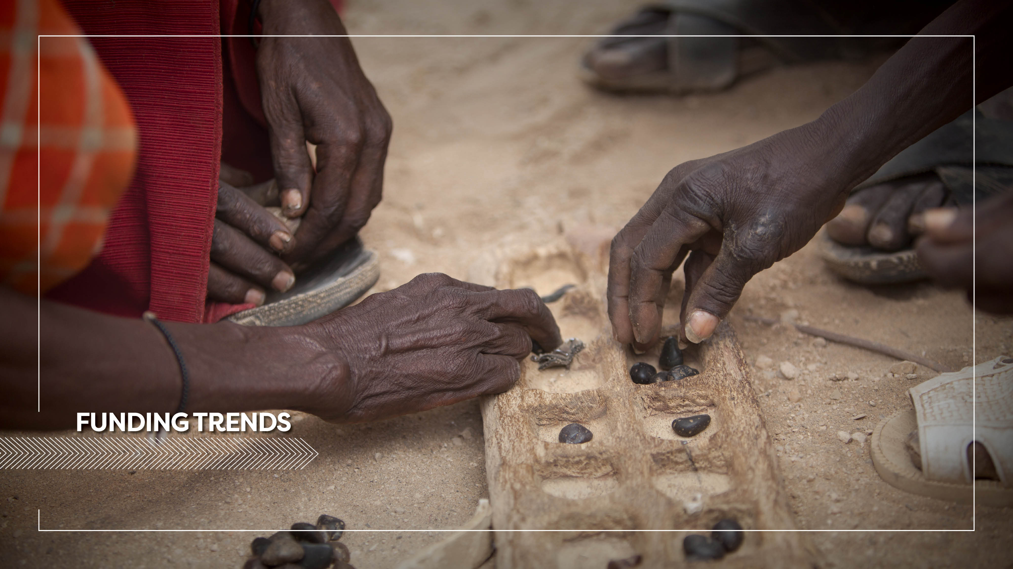

Slide 8
Who are the major players supporting condom programming?
 | Botswana | Kenya | Tanzania | Zambia | Zimbabwe
Donors | Government of Botswana USAID, GF secondary | Global Fund UNFPA USAID | Global Fund USAID UNFPA | UNFPA USAID | USAID UNFPA
Other funding (private capital) | Commercial sector | Commercial sector | Commercial sector | Commercial sector | Commercial sector
Source: Key Informant Interviews during country assessments

Slide 9
Proportion of Donor Funding for Condom Programming
2017 (est.)*

Slide 10
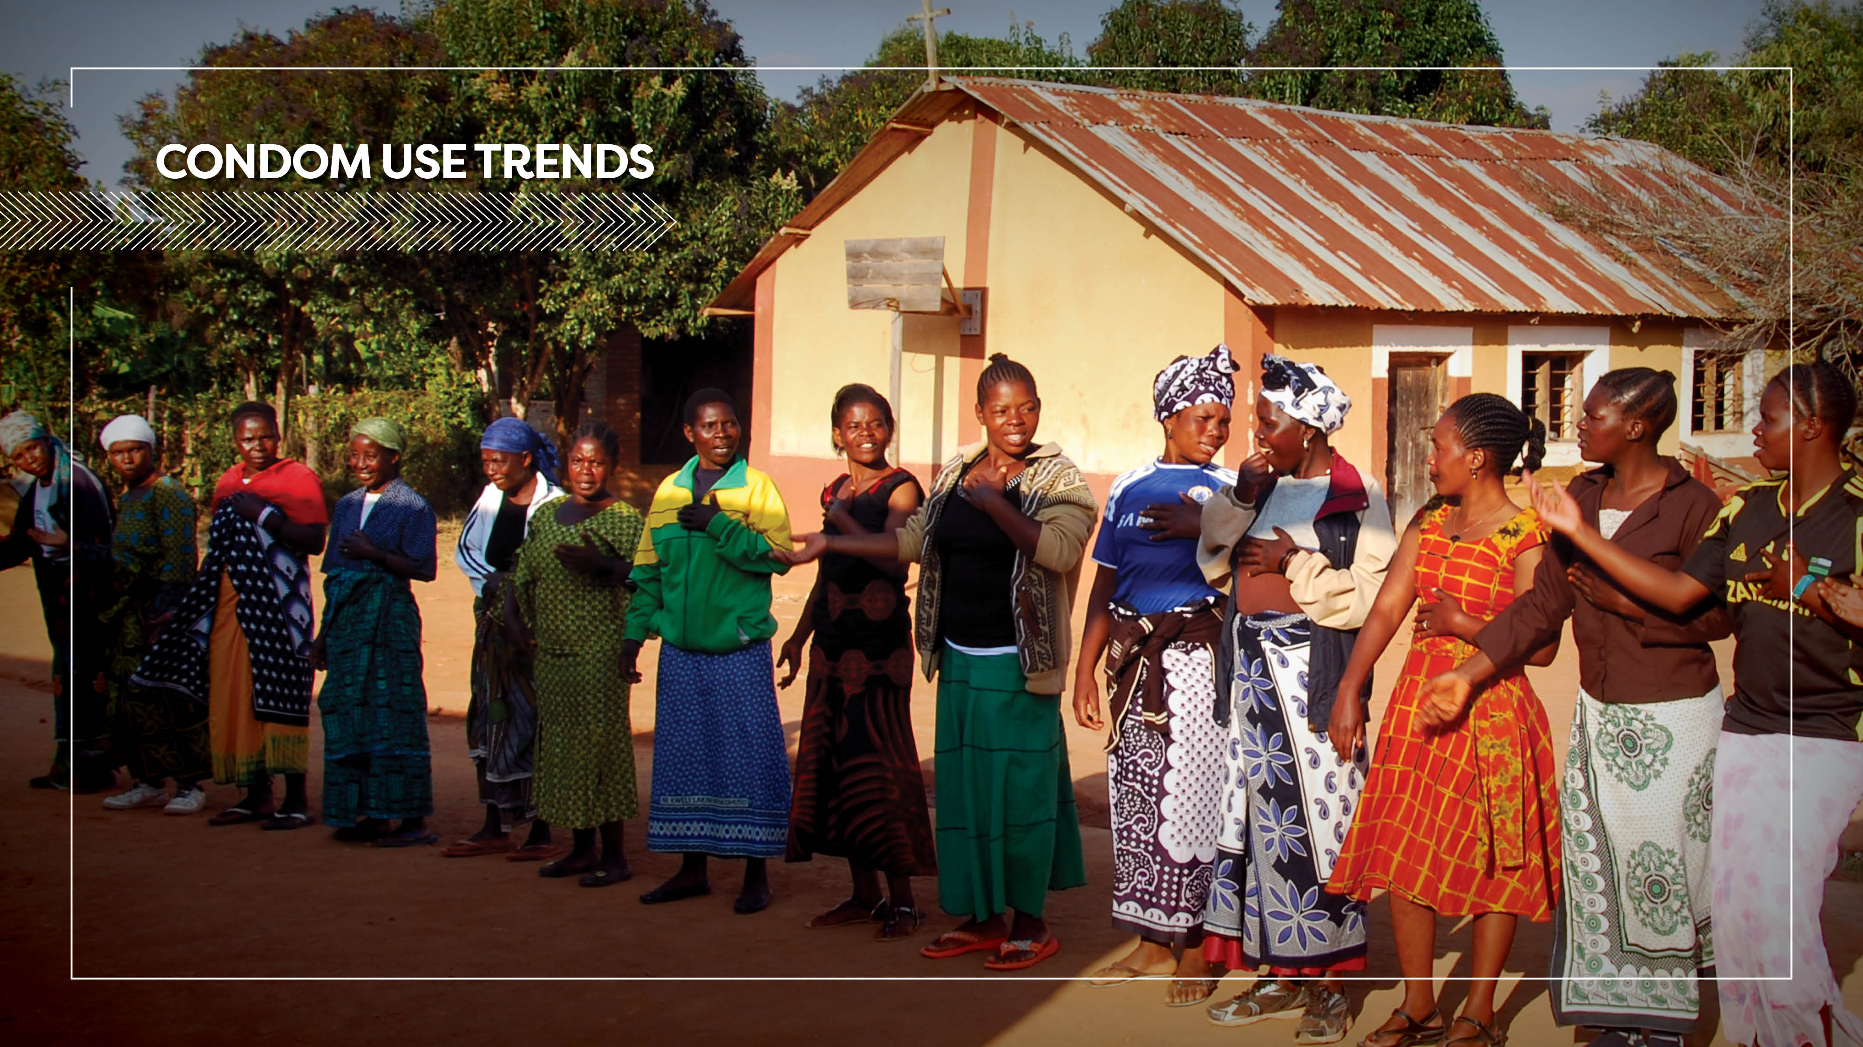

Slide 11
Despite decades of heavy investment, there remains a considerable gap between current condom Use and total condom Need.
Kenya
Tanzania
Zambia
Zimbabwe
Botswana
70%
78%
47%
32%
54%
Total Condom Distribution (2016)
Universe of Need
Source: Distribution data from in-country assessments and UNAIDS Condom Fast-Track Tool

Slide 12
Condom use trends are stagnant and even decreasing among certain populations.
Source: Uganda DHS (AIDS Indicator survey)
Source: PSK TRaC 2013
Source: 2010 DHS, 2011-12 THMIS, 2015 Omnibus Survey

Slide 13
Condom use is decreasing even in high risk sexual relationships.
Sources: THMIS 2007/2008 and THMIS 2011/2012

Slide 14
There is significant room to improve condom use in rural areas

Slide 15
Similarly, need to focus on condom use among lower wealth quintiles

Slide 16
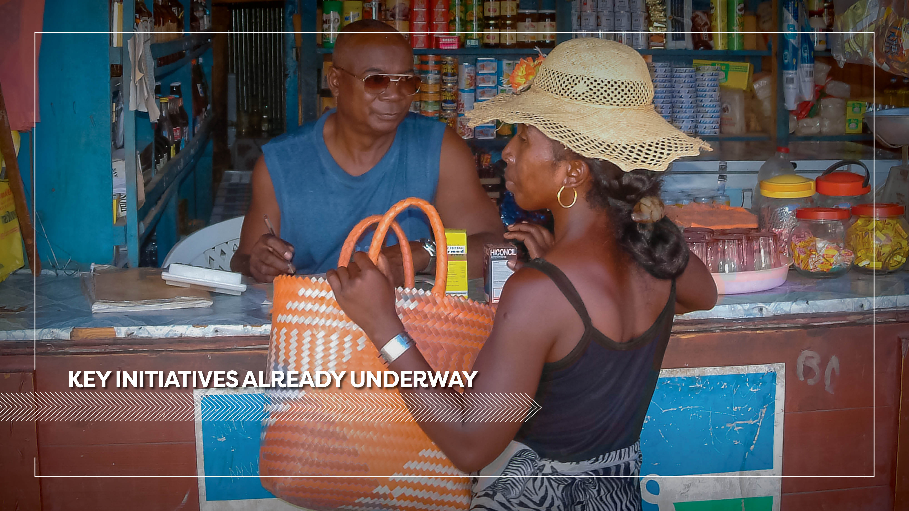

Slide 17
20x20 Initiative
Led by UNFPA, in collaboration with World Bank, RHSC, USAID and ILO
Objective is to increase the availability, access, and usage of 20 billion condoms in low- and middle-income countries by the year 2020
Two major workshops to date – Bangkok, Thailand (2015) and Windhoek, Namibia (2016)
  1st workshop – focused on condom gap in Africa; role of public sector, donors and SMOs in condom market; and challenges and opportunities for private sector investment
  2nd workshop – focused on better understanding African condom markets; and selected 5 countries (Kenya, Nigeria, South Africa, Zambia and Zimbabwe) for condom market intelligence data collection
Third workshop planned in January 2018 – agenda in development. Broad goals are to share condom market intelligence data and foster private sector engagement in African condom markets

Slide 18
AIDS Free Condom Market Assessments
Led by Abt Associates under AIDSFree and focused on 5 countries – in South Africa, Nigeria, Zimbabwe, Zambia and Kenya.
Analysis of retail environment for private sector investment in condoms – analysis will cover regulations, distribution infrastructure, demand and media channels for condom promotion and provision.
Condom social marketing pricing analysis – analysis of information on pricing of social marketing brands and price increases.
Willingness to pay studies - to determine price sensitivity in the condom market and impact of price increase in continued purchase of condoms.
All reports will be available on AIDSFree website from September 2017.

Slide 19
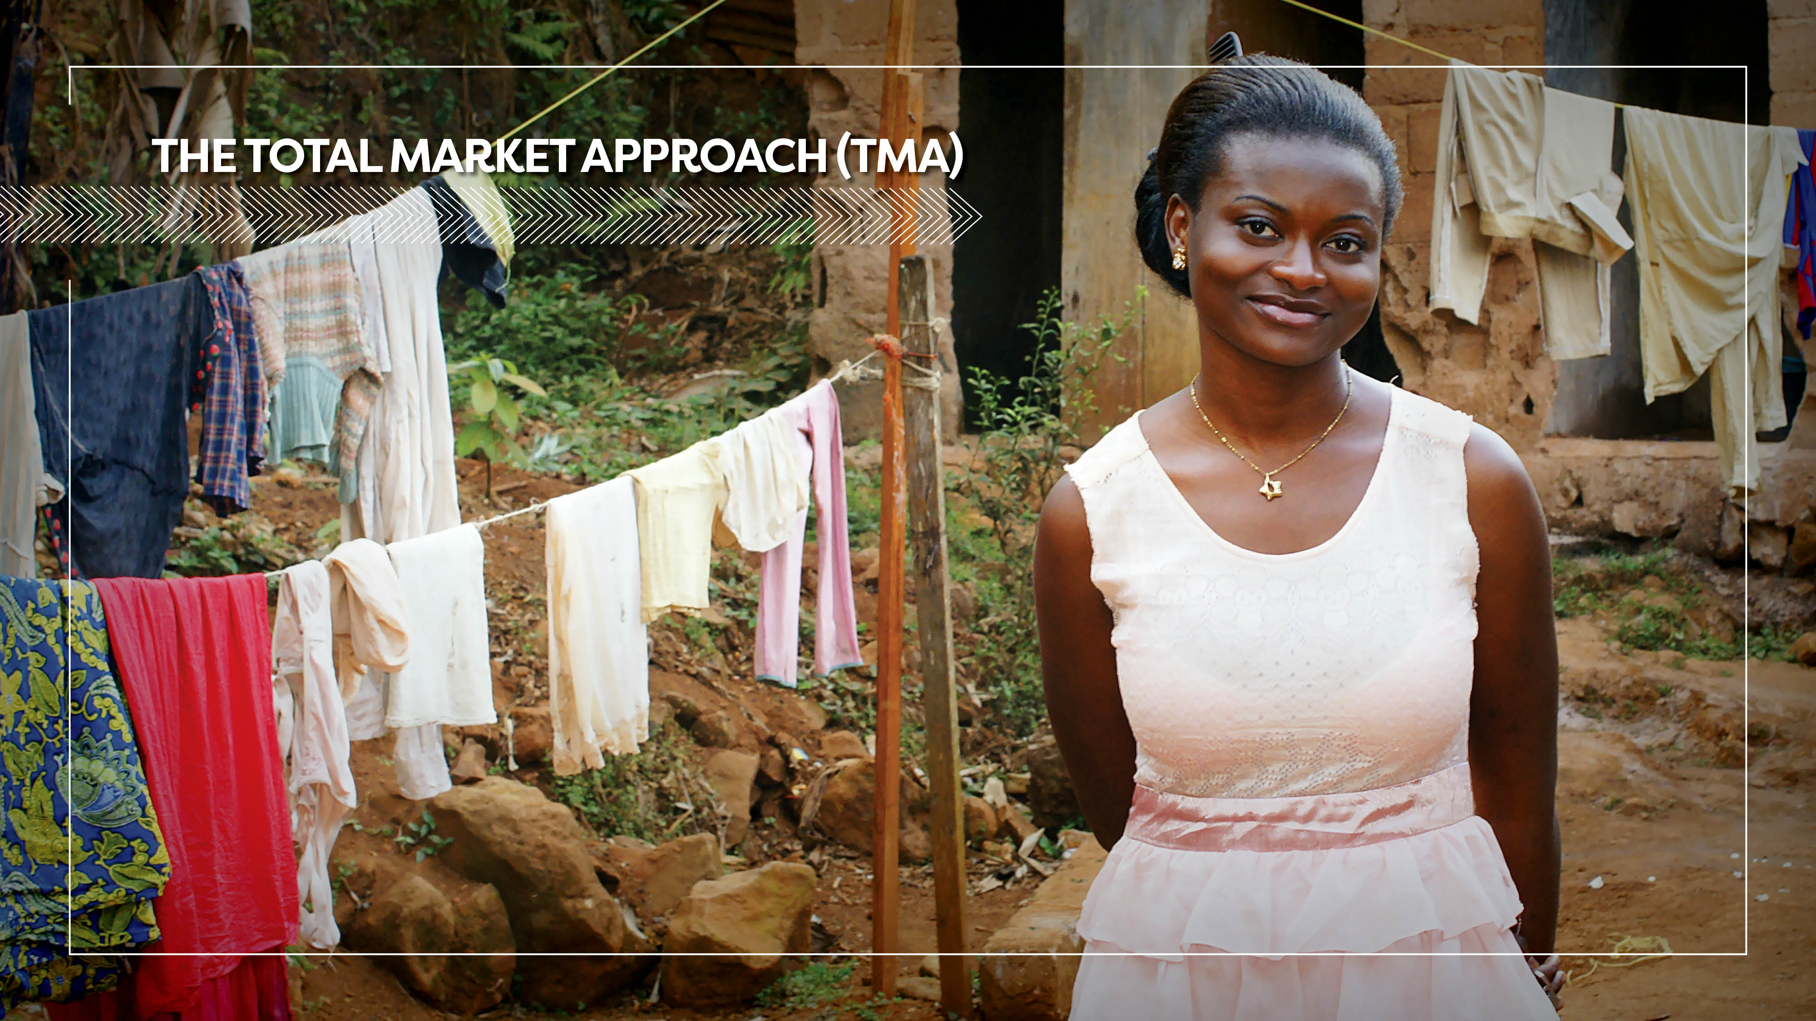

Slide 20
Interest in TMA at national level
 | Botswana | Kenya | Tanzania | Zambia | Zimbabwe
Current donor support for TMA initiatives? | No. Condom programming is primarily supported by GoB with a focus on free condom distribution. | Yes. DFID. Supported by funding through the ESHE project focusing on TMA for Family Planning (needs to further focus on condoms). | Yes. USAID. Supported through the Tanzania Social Marketing Project (TSMP) that ended in 2016 and new USAID funding for TMA under consideration for 2018. | Yes. USAID. Supported through the new DISCOVER-HEALTH project that has a TMA mandate. | No. USAID and UNFPA have made significant investment in supporting national capacity to implement Comprehensive Condom Programming.
TMA included in the national strategy? | Yes, but very high level - needs to be strengthened | Yes but needs to be strengthened. | Yes but needs to be strengthened. | No | No

Slide 21


Slide 22
The following slides provide:
Formula for a vision for condom programming that supports growth, equity and sustainability. This formula can be adapted for different markets based on the market assessments but is an overarching formula to aspire to over time.
Guiding principles for investing in condom programming. There is an urgent need for alignment of donor funding for condom programming. These principles apply across all types of donor funding and support and help ensure complementarity and mutually reinforcing approaches towards a common vision.
Standardized approaches. In an effort to leverage funding and build on investments, it is recommended to have standardized, transparent approaches and tools across donors and partners.

Slide 23
Alignment around a common vision for condom programming
Healthy market = ↑ Condom Volumes + ↑ Condom Use across all population groups +
↓ Reliance on external funding
Increase condom use to meet total needs of the population.
Increase in use must be equitable across age, gender, geography, wealth quintiles and risk behaviors.
Increase in use must be sustainable over time and reduce reliance on external funding.

Slide 24
Guiding principles for investing in condom programming
Know your market. Do not invest in any intervention until it is clear what its impact will be across all market players and market functions, and on users. Support market assessments in all countries.
Do no harm to the market. Use the market assessments and other guidance to determine possible market distortions due to funding, including decreased sustainability.
Invest in systemic corrections to failing market functions. Donors must resist picking market winners. Rather than funding one sector or partner over another, or investing in the “easy” thing (more condoms in warehouses, for example), donors should fund the fixes to broken market functions that will have an impact on the total market and move it towards growth, equity, and sustainability.
Consumer choice is key to growing use. Consumers need more choices for condom brands, but also more choices as to where they get their condoms, at what price, etc.

Slide 25
Use standardized approach and tools
Ensures alignment of efforts across donors, Government agencies and all stakeholders involved in condom programming
Helps determine baseline levels in each country and track performance over time
Provides common language around gaps and opportunities in condom programming to inform current and future investments
Helps to develop and track performance metrics for Strategic Framework for condom programming
Allows for cross-country comparison over time to share lessons learned

Slide 26
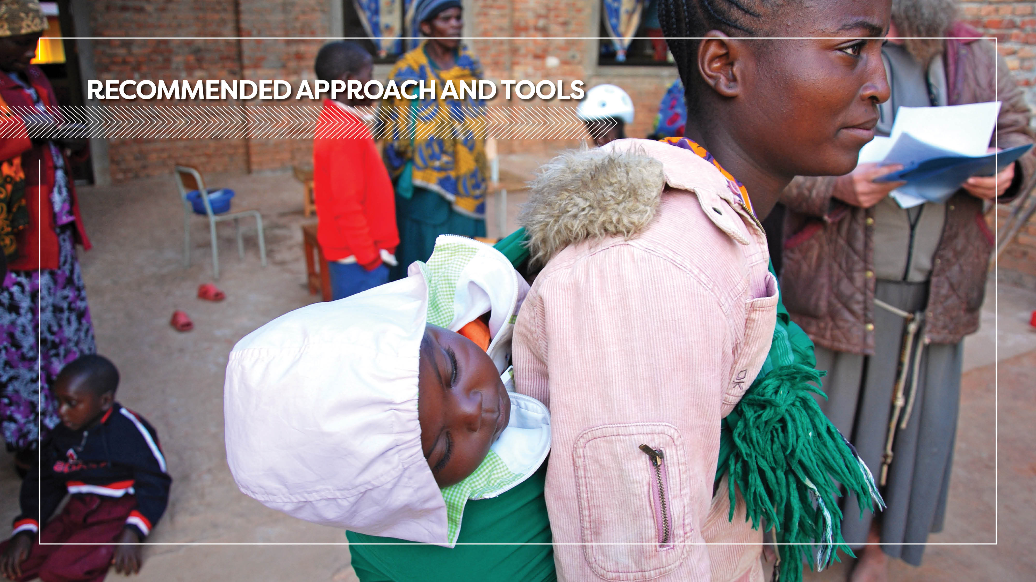

Slide 27
The Condom Program Pathway
This approach was developed with support from the Bill & Melinda Gates Foundation with technical inputs from the Condom Working Group.
The approach was based on extensive literature review and inputs from global condom stakeholders.
The approach consolidates frameworks and tools from a range of different organizations.
Fieldwork in five countries helped to test and refine the approach and tools.
The Condom Program Pathway includes all the necessary elements for a successful condom program at the country level.

Slide 28
Condom Program Pathway
Condom Program Stewardship
Condom Market Development
Condom Market Management
Leadership & Coordination Financing Policy & Regulation | Market Analytics Supply Demand | Equity Sustainability

Slide 29
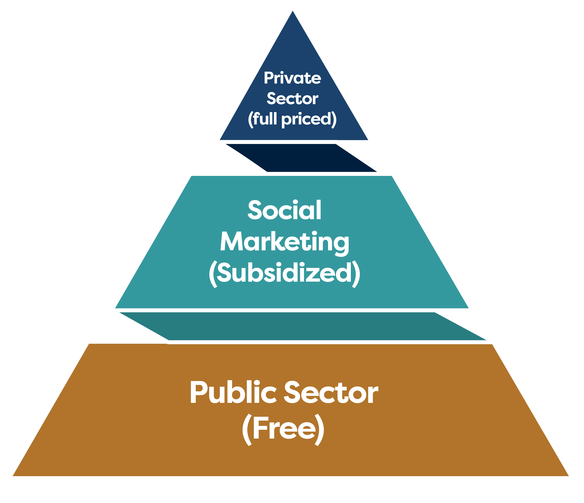
Moving from TMA Sector Focus →
Market Function Focus
Concept of Total Market Approach has been around for over a decade.
TMA as an operational framework is limited to analysis of the role of sectors, rather than understanding specific functions in the market that are underperforming, and the causes of that under-performance.

Slide 30
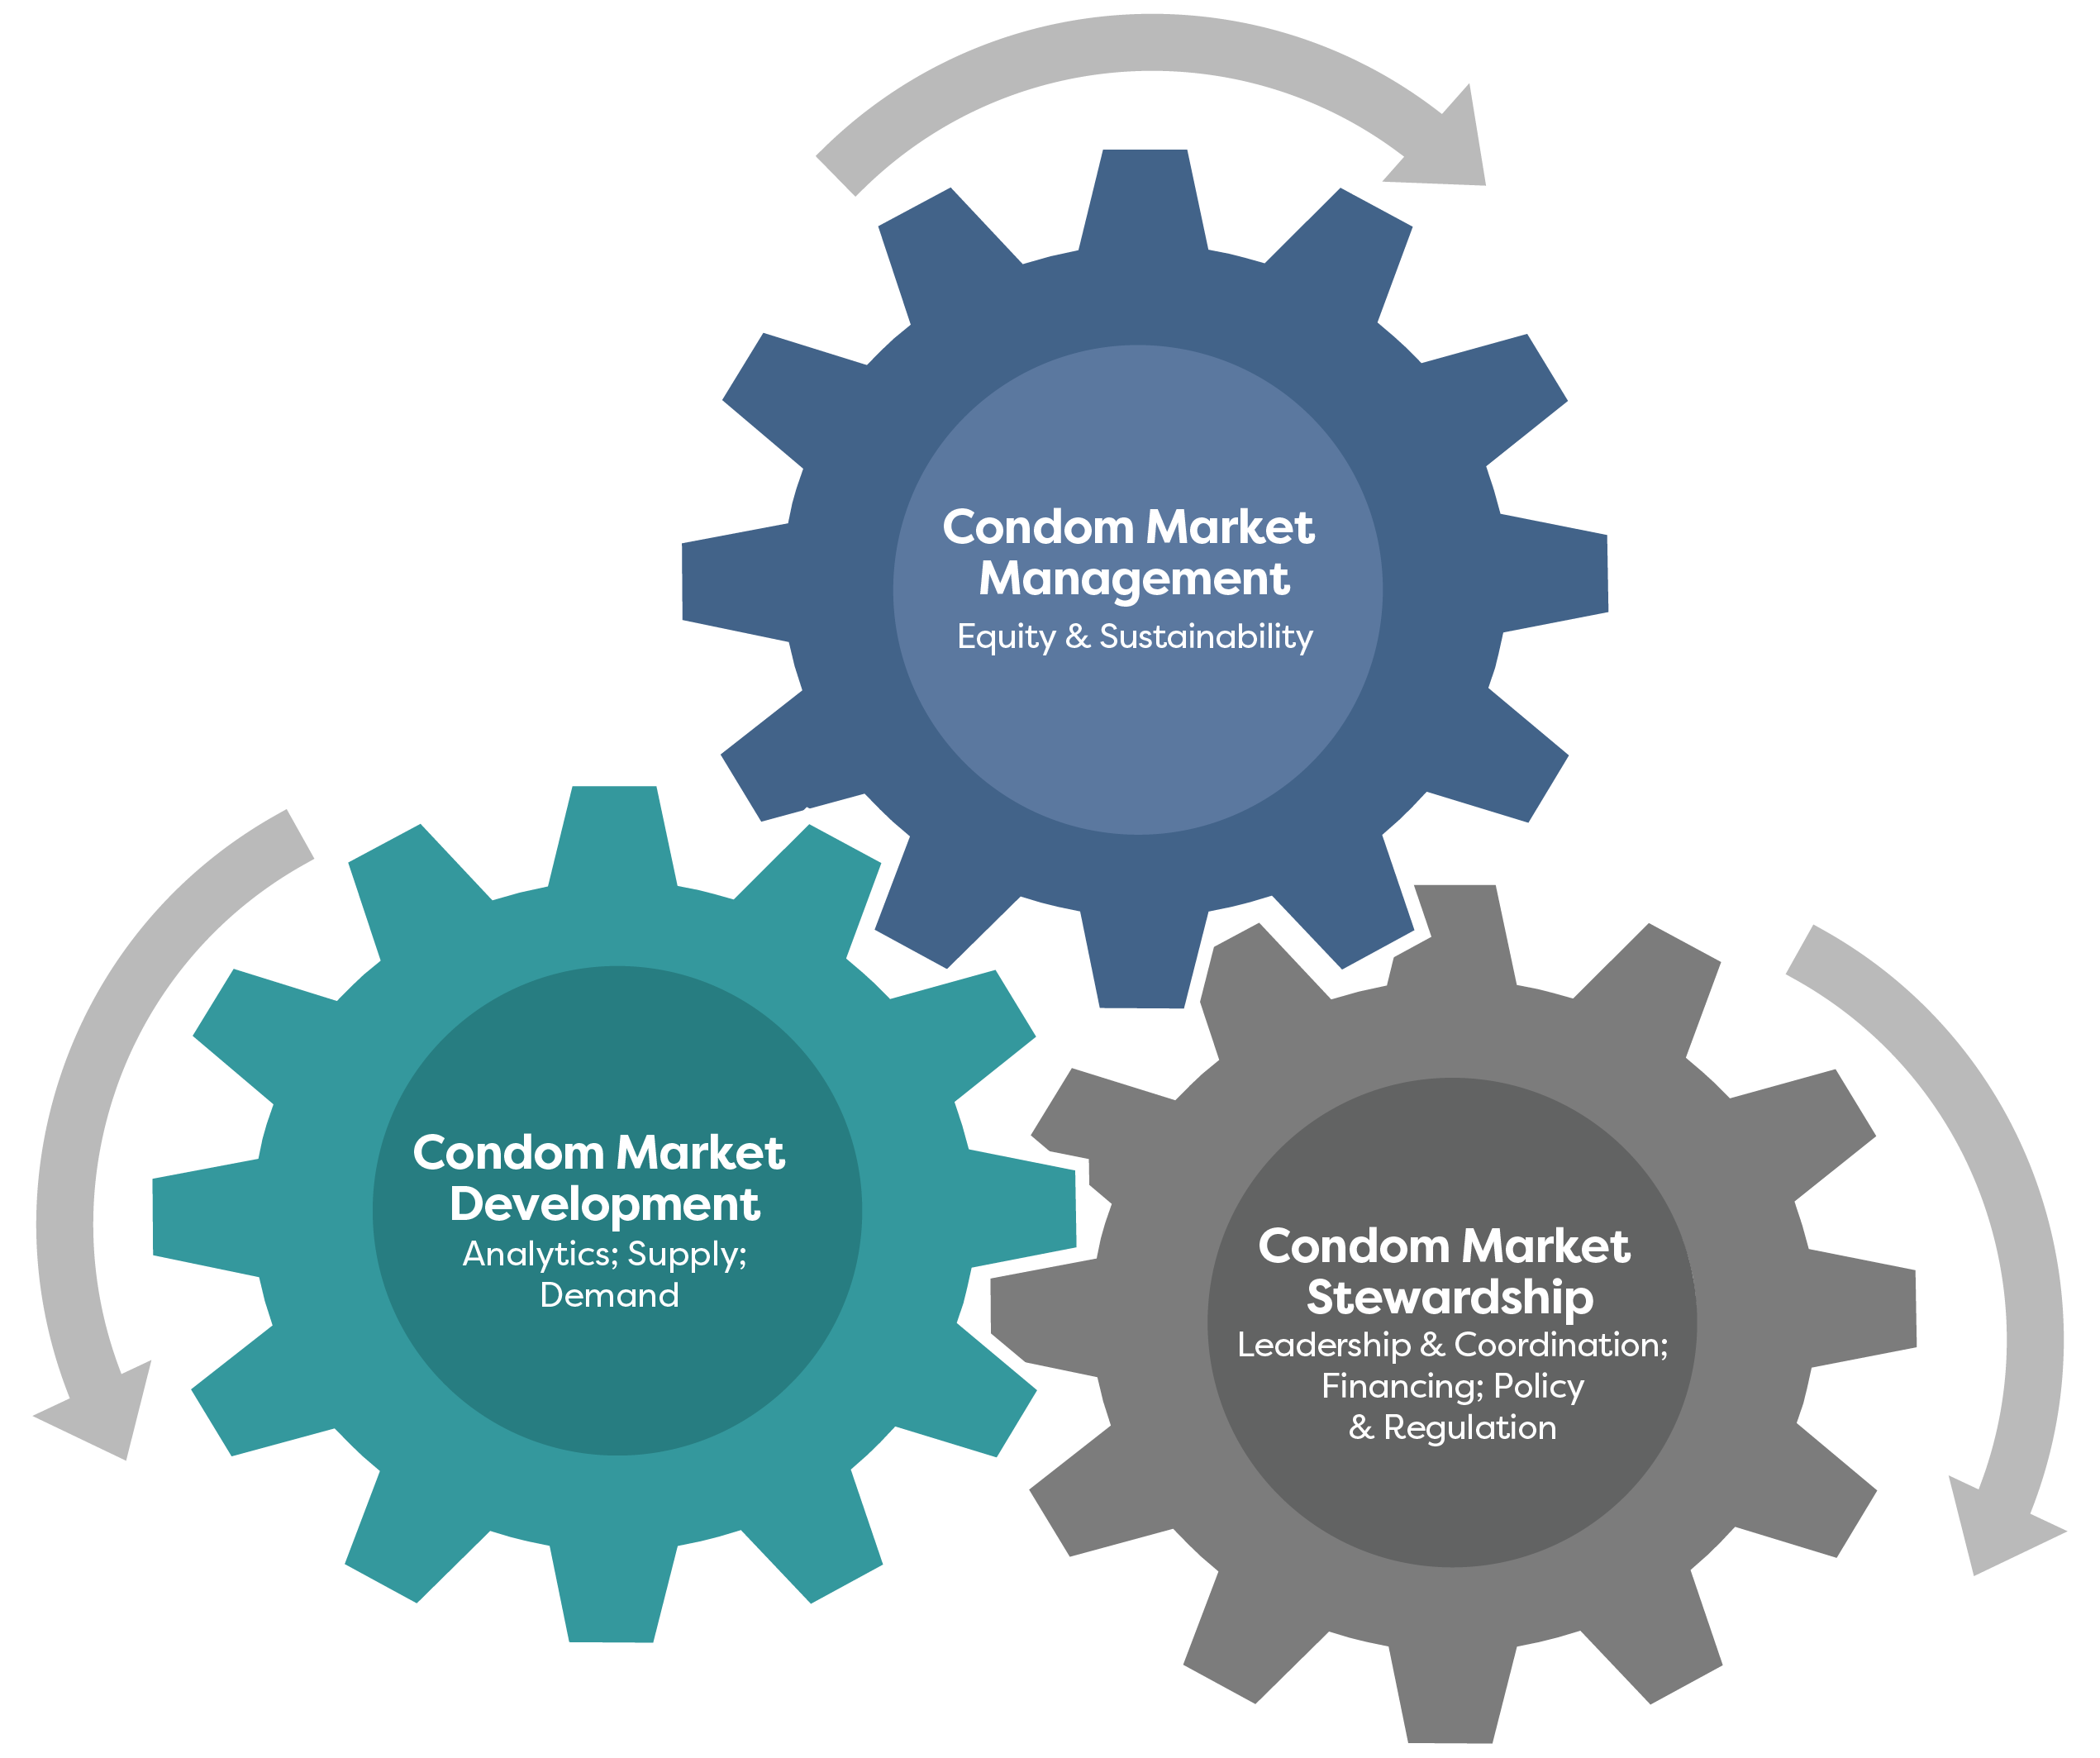
Functions

Slide 31
Condom Program Stewardship
The work that must occur at the national level to create a favorable environment for a condom market. High quality market stewardship relies on:
Leadership & Coordination Capacity | Government is responsible and accountable for overall direction of program, including coordination of market players, such as market facilitator, donors, and private actors.
Financing | Coordinated and adequate financing available for all critical aspects of condom programming, and subsidy used appropriately to addresses gaps in the condom program.
Policy & Regulation (includes taxes, tariffs, testing, etc.) | Enabling environment is supportive of all market players and conducive to market growth across players and target populations, ensuring compliance with national standards.

Slide 32
Condom Market Development
The process of improving the condom “category” within a country. This is an aggregation of all the market actors across the core functions of demand and supply. Condom market development relies on:
Market Analytics | Market data needed to analyze condom market performance across all players in order to adjust and plan for interventions. Data also help leadership teams understand changes in epidemiology and market evolution, as well as changes in local and global policy.
Supply | Comprehensive approach looking at the entire value chain in the public sector and across private channels, including quantification, forecasting, procurement efficiencies, supply chain management and pricing structures.
Demand | Ensuring increased and sustained demand with a focus on increasing use within priority target populations.

Slide 33
Condom Market Management
Occurs at the product and project level, implemented by market actors supporting condom programs. The goal of healthy condom programming is to grow sustainable, equitable condom markets, driving use toward total need.
Equity | Equitable condom programs address specific barriers across target population segments based on age, gender, geography, wealth quintile and risk behaviors. Achieving equity requires the application of subsidy to address gaps in use.
Sustainability | Sustainable condom programs include diversity of funding sources (external, domestic and private sources) as well as business models that efficiently allocate resources to achieve market growth.

Slide 34
Market Assessment Tools
Comprehensive Condom Indicators
Condom Data Analysis & Charts
Condom needs estimates UNAIDS Condom Fast-Track Tool
Detailed guidance to support use of these tools is available @ http://mannglobalhealth.com/
Contact Chastain Mann (chastain@mannglobalhealth.com) for additional details.
Notes:
Slide 34 - Fast-Track Tool needs to be capitalized in text on lower right side of slide

Slide 35
Market Assessment Tools
Tools for Market Assessment
1 | Key Informant Interview Guide
2 | Condom Market Landscaping Guidance
3 | Value Chain Analysis Questionnaire
4 | Condom Data Analysis & Charts (Excel)
5 | Comprehensive Condom Indicators (Excel)
6 | Condom Needs Estimate – UNAIDS Fast Track Tool
7 | Market Structure Sample
8 | Generic Letter of Introduction
9 | Guidance on How to Use Tools
Detailed guidance to support use of these tools is available @ http://mannglobalhealth.com/
Contact Chastain Mann (chastain@mannglobalhealth.com) for additional details.

Slide 36
Condom Pathway Working Prototype Dashboard
A draft of this tool is available here.
Contact Chastain Mann (chastain@mannglobalhealth.com) for additional details.

Slide 37
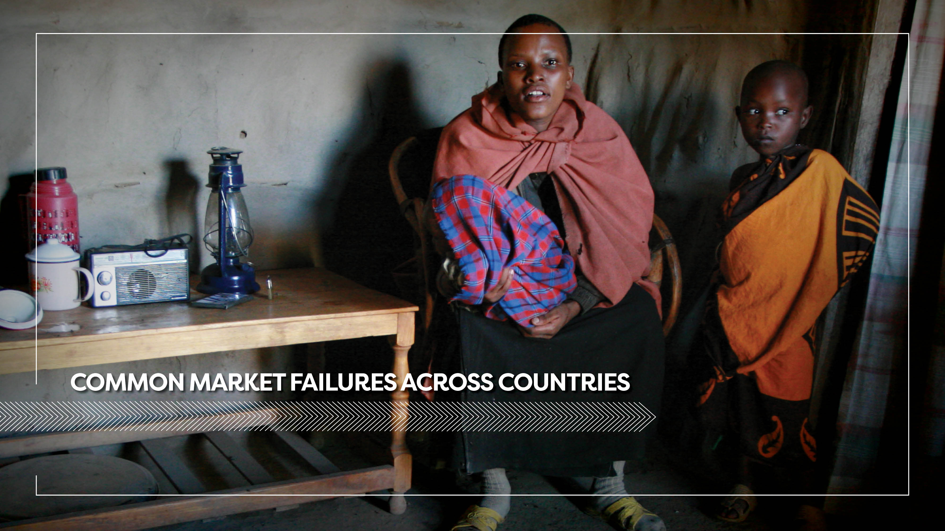

Slide 38
Condom Program Stewardship
Missing link between country-level strategy documents, work plans, and resources
Inadequate investment in the capacity needed for national stewardship.
Understanding of TMA is limited to the role of different sectors and does not address broader issues of equity, sustainability and an enabling environment.
Lack of clear healthy market vision, strategic framework and performance indicators to inform analysis and decision-making
Failure
Root
Causes

Slide 39
Condom Program Stewardship
Insufficient stewardship functions supported by market facilitation
Previous interventions focused primarily on demand and supply functions with limited attention to enabling environment factors
Inconsistent approaches to market assessments led to limited understanding of market failures across functions and players
Some aspects of market facilitation were performed by direct implementers, leading to tensions and tradeoffs
Declining funding for entities traditionally supporting this role has left a gap in the market
Failure
Root
Causes

Slide 40
Condom Program Stewardship
Failure
Lack of coordination around financing for all aspects of condom programming
Lack of common understanding of healthy market vision, including among donors
Insufficient understanding of market development approach to identify underperforming market functions and finance/implement interventions to address them
Donors operate on different timelines with varying goals, and “pick winners” rather than fund market function corrections
Lack of use of sustainability and market performance metrics at donor and government level to inform resource allocation
Root
Causes

Slide 41
Condom Market Development
No condom program is consistently tracking the market in terms of equity, sustainability, or growth
Limited investment in understanding the market and consumer needs, as a basis for appropriate strategies
Past investments made in sector-specific research were not transparent or widely disseminated among all market players
Market and Consumer information is neither centrally planned nor managed by an independent coordinating agency
Limited tracking of uptake/use at country level
Failure
Root
Causes

Slide 42
Condom Market Management
Limited Role of commercial actors in diversifying the national response and ensuring long-term sustainability of the condom market.
Burdensome regulatory requirements for registration of new brands in private channels
Requirement for all condoms to be tested in-country results in stock and inventory challenges and higher costs for private players
Lack of existing infrastructure and systems to get total market information needed for business planning and investment decision-making
Too much subsidy in the market creates an uneven playing ground for appropriate pricing of commercial brands
Failure
Root
Causes
Notes:
missing the words Failure/Root Causes from the left side of the slide

Slide 43
Condom Market Management
Failure
Excessive subsidy on poorly targeted free or overly subsidized social marketing programs is a barrier to commercial actors, and carries a big opportunity cost in neglected interventions
Current investments in public sector and social marketing programs are not addressing last-mile and equity challenges of assuring access and affordability among target populations. Bulk of funding is spent on maintaining core operations.
Donor subsidy is untargeted and misaligned to support heavily subsidized condoms (public and social marketing brands) across all wealth quintiles, and mainly serves general population condom needs
Root
Causes

Slide 44
Condom Market Management
Lack of adequate investment and coordinated efforts in demand creation to ensure continued growth of the condom market and to increase condom use across all target populations
National and donor resources focus on commodity procurement and not on targeted demand creation and social behavior change to address systemic and socio-cultural barriers among key and vulnerable populations
Limited investment in understanding the market and consumers’ needs as a basis for the development of appropriate behavior change strategies
Lack of clear strategy to integrate condom programming (and ensure condom supplies) within currently-funded HIV prevention and treatment programs through NGOs and CSOs
Condom demand creation is deprioritized compared to investments for scaling other aspects of the HIV response
Failure
Root
Causes

Slide 45
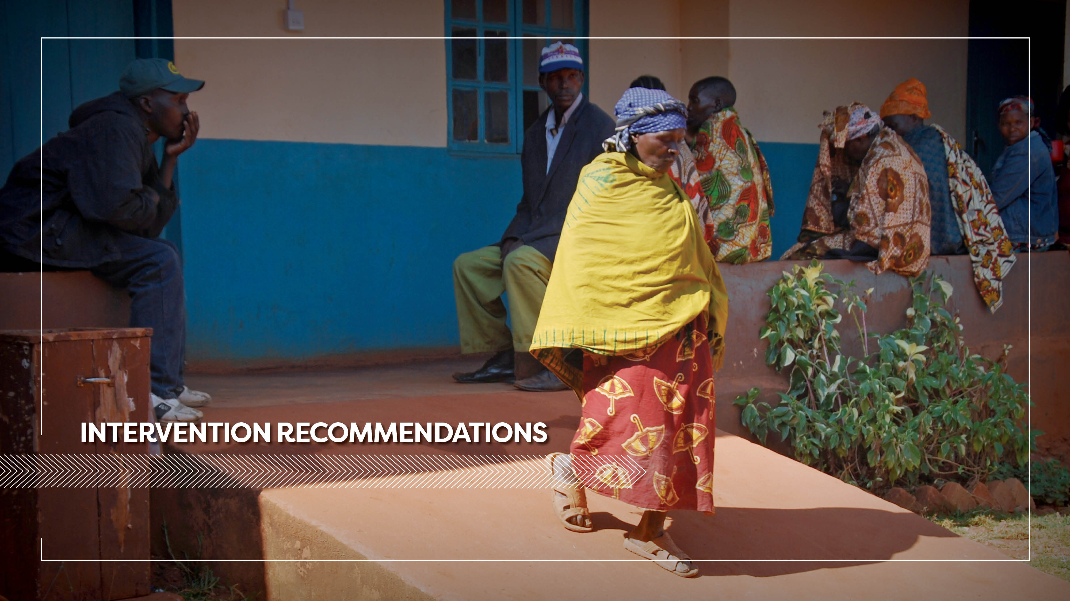

Slide 46
Market Failures & Specific Interventions | Missing link between strategy & Op plans | Condom market performance isn’t tracked / analyzed | Limited role of commercial actors | Excessive subsidy for poorly targeted free or overly subsidized SM programs | Lack of investment in harmonized demand creation | Lack of coordination around financing for all aspects of condom programming | Insufficient Stewardship functions supported by capable market facilitation
Assign Market Facilitator
Invest in Market Information
Targeted demand generation to move use closer to need
Improve Supply by leveraging current and additional resources for all players

Slide 47
Specific Intervention
1
Assign a market facilitator to foster an enabling environment for the total condom market across all market players.

Slide 48
Recommendations for Market Facilitator
A market facilitator role is critical to support governments to steward national condom programs, driving a vision of a healthy, sustainable condom market.
Ensure clear mandate (SOW) and funding for sustained engagement of 3-5 year period.
Market facilitator also conducts mapping of ALL market players, current and potential, developing plan to implement various aspects of condom programming.
Donors require all current implementing agencies to share information and data with market facilitator.
Market Landscaping & Strategy Development
Lead on Market Intelligence Agenda
Planning, Forecasting, & Quantification
Engage All Sectors (including PPP w/ Commercial Sector)
Coordination & Advocacy
Regulatory & QA Guidance

Slide 49
Role of the the Market Facilitator - Market Landscaping
& Strategy Development
Conduct market assessments, regularly updated, to develop baselines, identify prioritized market failures, and continuously understand the evolving market. Develop a vision for a healthy condom market, where increasing use supports total need and equity, while reducing reliance on external funding. Develop a total market strategic framework to include indicators & performance tracking plan, supported by routine review of progress by national groups (e.g. NACA/NACP, MoH, FP TWG). Design interventions to achieve the vision for condom markets, focusing on activities that address underlying root causes of prioritized market failures. Build capacity with key government agencies to promote market development approaches & needs, achieve buy-in for vision and strategy, and improve inter-agency and inter-sectoral coordination.

Slide 50
Role of the the Market Facilitator - Coordination & Advocacy
Oversee & coordinate interventions addressing prioritized market failures. Advocate within governments & to donors to: Ensure domestic commitments for condom programming & medium- to long-term commodity security Strategically tackle interventions to address priority market failures and weaknesses; Lay out the case for sustainable condom markets, and the need to target resources; Address policy and regulatory barriers (such as taxation, registration, testing, etc.) Secure integrated financing to support under-funded interventions; Address national policy barriers for target populations (e.g. MSM and lubricants, youth and condom access, etc.), with support of CBOs/NGOs. Vitalize condom TWGs or equivalents – ensuring the right players convene regularly, and meaningful engagement focuses on activities that are prioritized in strategies. Facilitate the sharing of key information, strategies, & coordinated activities; coordinate market intelligence efforts with all market actors and stakeholders, regularly updating the market landscape to identify market weaknesses and progress on priorities.

Slide 51
Role of the the Market Facilitator - Market Intelligence
& Data Analysis
Own the market information agenda. Coordinate data collection, analysis, management, quality, dissemination and application in the development of strategies and activities supporting sustainable condom use. Wide and transparent dissemination of information for evidence-based decision-making will occur through regular meetings of TWG and dissemination meetings, supporting the translation of market intelligence to informed decisions. Develop and regularly manage progress against TMA indicators. Engage all market actors in cost-sharing for market information, through a collective impact agenda. Improve understanding of impact of financing decisions: collect information by % commodities supported by funding source, % reliance on subsidy, and cost-recovery by brands. Improve condom use tracking: Use over Need analysis using UNAIDS Fast-Track Tool, trends in % condom use by key and vulnerable populations, % condom use by youth (15-24 men and women) and % condom use by quintile and geography. Improve monitoring of free condom distribution through health facilities, community distribution, and other distribution points, to track effectiveness of targeting.
Notes:
Note that I made a copy edit on this slide.

Slide 52
Role of the the Market Facilitator –
Planning, Forecasting, and Quantification efforts
Support forecasting and quantification efforts for free condoms, accounting for the condom market contributions of social marketing and commercial actors to different populations. Monitor external and domestic procurement. Develop distribution plans in line with strategy. Ensure that all condom quantification and forecasting (for HIV and FP) adhere to the vision of a sustainable market. Recommend ways to improve segmentation strategies. Map current and required funding to support the strategic framework. Review all funding requests (e.g., Global Fund) or procurement plans for condom programming (e.g., USAID, UNFPA) to ensure alignment with strategic framework and prioritized activities.

Slide 53
Role of the the Market Facilitator –
Regulatory and QA Guidance, Engaging Commercial Actors
Regulatory & Quality Assurance support
Support efforts that ensure a level and transparent regulatory playing field for product registration. Reduce friction of registering, importing, and marketing quality condoms. Support efforts to reduce the cost of importing and marketing condoms, including exploration of VAT exemption, and reducing registration costs and excise duties on condoms. Update importers, distributors and manufacturers about evolving regulatory requirements and processes. Support efforts to incorporate international best practice around quality assurance, including acceptance of qualified pre-shipment quality testing.
Engaging Commercial Actors
Share market information with commercial actors, and identify investment opportunities for commercial brands. Identify barriers faced by commercial actors, and mobilize resources and support to remove those barriers and increase commercial investment in the market. Ensure investments in condom markets benefit all sectors, including commercial actors. Champion the role of commercial actors in condom strategy development and roll-out.

Slide 54
Structures & Actors Supporting Market
Facilitation Efforts
Market Facilitators should provide neutral, transparent, and independent support. Based on available resources in-country, the market facilitator role could be held by independent facilitators, or by existing market actors such as social marketers or the government. If the Facilitator is an existing actor, the burden is to assure neutrality.
Structure and “Home” of market facilitator
  Housed in re-vitalized Condom TWG, reporting directly to Market Stewards (typically, the government)
  Focus on capacity building efforts for improved government stewardship function
  Not required to directly implement all tasks, but to convene and coordinate what needs to occur, leveraging resources to deliver.
Notes:
Slide 54, check capitalization of market facilitator, Market Facilitator. We use several variations on this one slide.

Slide 55
Structures & Actors Supporting Market Facilitation Efforts
 | Independent facilitator | Existing Market player (e.g., Social Marketer) | Government
Pros | Neutral coordination serving needs of all sectors and actors. Seen as impartial, and possibly better able to garner cooperation from commercial players. | Solid understanding of country-specific market dynamics, often already present in country, likely producing market data already. | Playing the full stewardship role – including facilitation -- enhances leverage to convene relevant actors and harmonize interventions.
Cons | Lacks ‘teeth’ to support coordination, unlikely to bring familiarity to market and relationships with market actors, as current actors do. | Perceptions of bias, vested interest in own brands. Perceived inability to convene commercial actors or other social marketing competitors. | Unlikely to possess skills, tools & capacity to facilitate; also perceived as a market actor with vested interests.
Notes:
Slide 55 extra space before the work "and" in the bottom left box in the chart.

Slide 56
Best Practice – Highlighting the Market Stewardship Function
The stewardship role requires establishing a strategy in support of a vision for a sustainable, healthy condom market; coordinating the efforts of all market actors to implement prioritized interventions; monitoring and regulating the quality of commodities; monitoring progress in market indicators; and collecting, analyzing and disseminating market data to better manage the market.
Financing & Understanding the Market
Leadership & Coordination
Rules & Regulation
Mandate & Governance
Sufficient Funding sources
Recognized Need
Monitoring & Evaluation
Human Resources
Structures in Place (ie, TWG)
Reducing Reliance on External Subsidy
Data Collection
Data Analysis
Data Management
Data Quality
Data Dissemination & Application
Legal Framework
Regulation and Policies
* Adapted from the Abt Associates: Total Market Approach Stewardship Capacity Assessment Report. http://www.rhsupplies.org/uploads/tx_rhscpublications/Total_Market_Approach_Stewardship_Capacity_Assessment_Report_-_07_31_15.....pdf
Notes:
Slide 56 - what are the little numbered circles 1, 2, 3? Do we need those? Also a lot of capitalization used on this slide - is it necessary? (Ex: Reducing Reliance on External Subsidy - could it be Reducing reliance on external subsidy)

Slide 57
Specific Intervention
2
Invest resources in building market information as a public good for evidence-based decision making at all levels of the market.

Slide 58
Market Intelligence
Type | Information collected | Frequency | Agency
Population-Based Surveys | Demographic and Health Surveys including AIS, SPA, population-based HIV and sexual behavior surveys | Once every two years | Government agency
Market Overview | Use over Need analysis (based on UNAIDS calculator), types and numbers of market players, distribution volumes (reported by players), brands and variants, recommended prices and % reliance on subsidy | Once a year | Market Facilitator & key Government agency lead (with direct inputs from market players)
Market Audits/ Surveys (along the value chain) | Information by brand and channel – availability, distribution volumes, consumer and trade prices, trade and consumer promotions, off-take (average monthly/quarterly distribution) | Quarterly | Market Facilitator (outsourced to a research agency)
Target Group Surveys | Qualitative surveys to understand socio-cultural barriers to condom use among target populations, including most at-risk populations, youth and other vulnerable populations | Once every two years | Existing HIV/FP partners/SBC lead agency/Market Facilitator along with key Government agency lead
Consumer Segmentation | To identify clusters of consumers for improved condom promotion and marketing efforts | Once in 3-4 years | Market Facilitator (in partnership with private players)

Slide 59
Market Overview Research -- detail
Type | Description
Market Overview | Consolidated by Market Facilitator to support national lead agency (e.g., CWG) and reported monthly by market actors involved in distribution and promotion of condoms Facilitated by an independent agency (to ensure comprehensive and transparent report) and used to inform forecasting and planning for future procurements as well as resource allocation for condom programming Recommended to include additional market performance indicators once Condom Vision and Strategic Framework are finalized Build on baseline information collected from initial market assessments

Slide 60
Market Audits/Surveys -- detail
Type | Description
Market Audit/Surveys | Information can be collected at different points in the supply chain (trade-off based on level of precision and resources available) Information from importers/distributors is less expensive and easier to collect but does not provide information on consumer pricing or promotions. Over- and under-stocking (or stock-outs) are harder to track. Information from retail outlets is more expensive but higher quality and more detailed, including stock movement, actual consumer prices, promotions and consumer preferences. Frequency (monthly or quarterly) is very important criterion, to track changes in the market Information collection design should be based on inputs across all market players, with standardized reporting for transparent dissemination Usefulness will help ensure cost-sharing with commercial players over time. Addresses challenges with current limited distribution surveys (project based and include select products only). Ideally led by existing, large research agency (IMS, Nielsen, TNS) with support from Market Facilitator Investment can be leveraged with other HIV and FP products for cost-sharing and sustainability over time

Slide 61
Target Group Surveys -- detail
Type | Description
Target Group Surveys | Qualitative surveys with specific target groups to determine socio-cultural factors influencing condom use Methodology could be in-depth interviews or focus group discussions depending on target group Recruitment of respondents and sampling could leverage existing programming for HIV and FP services among target groups Findings would help inform consumer segmentation quantitative survey as well as targeted SBC interventions.

Slide 62
Consumer Segmentation -- detail
Type | Description
Consumer Segmentation | Timing is critical as market is currently defined by low-priced or free condoms, and brand-equity is a direct function of price and lack of choice. Basic segmentation (based on age, gender, wealth quintile, geography) can be done using DHS data for secondary analysis. Research design and information need to be driven by existing and potential commercial players (for cost-sharing). Recommended methodology is multi-dimensional segmentation based on combination of product preference (functional benefits); lifestyle (emotional benefits); purchase patterns (heavy or light users, consistent or inconsistent); and use preferences (partner type, occasion). Objective is to identify condom category and brand drivers to inform marketing mix (product, price, place and promotion) across all brands in the market.

Slide 63
Specific Intervention
3
Ensure highly targeted and leveraged donor investment in Demand needed to move Use closer to Need.

Slide 64
Types of Demand Creation
Branded Communications | Evidence-based SBC
Primarily focused on differentiating between brands to promote market share and increase volumes. Intended primarily for general population sales. Limited category-level benefit in mature markets or for priority target groups. In most markets, branded communications can be led by private investment and no longer require donor funding. | Can be customized for specific target groups based on deeper understanding of socio-cultural barriers to condom use, and implemented through national campaigns (especially for youth), interpersonal and community level activities (for most at-risk populations).

Slide 65
Leveraging Best-Practice Demand Creation
Global Level
Identify best practices for condom demand creation by target populations, and shared across countries (well documented)
National Level
Currently funded and future planned investments in increasing coverage of HIV services among priority target populations can be channels for integration of condom promotion and distribution efforts (e.g. systematic investment in using male circumcision promo and service delivery channels for condom programming for young men).
Community Level
Ensure standardized and evidence-based approaches to condom promotion among existing CBOs and CSOs that work with priority target populations.
SOPs developed for CBOs and CSOs to access free condoms (from public sector facilities) to distribute to target pops. through community mobilization and interpersonal activities.

Slide 66
Best-Practice Demand Creation
Shift from awareness-type IEC activities to integrated, user-driven communication design and delivery. Evidence-driven Social Behavior Change Communications (SBCC) can lead to increased condom use across all brands and all market players.
Awareness-type activities relying on IEC approaches
Integrated, user-driven communication design and delivery

Slide 67
Demand Creation Activities – considerations
Extensive best practices in user-driven demand creation exist, and can inform country specific strategies and approaches. Countries should design interventions that address persistent barriers to use in their markets.
Condom demand creation needs to be more than an afterthought in the cascade-to-treatment continuum. Thoughtful, well designed SBCC can be integrated into test and treatment programs.
  Target youth & adolescents (focusing on those in multiple partnerships, higher risk sex), complementing existing work with key populations.
Invest in integrated, evidence-driven SBCC to address persistent barriers to condom use among key populations, addressing not just the individual, but key influencers of that behavior (for example, with sex workers, design interventions addressing the roles of peers, brothel managers, clients, surrounding community).
Demand creation for condoms could deploy a ‘Surround and engage’ approach - media channels reaching priority populations, integrated with targeted interventions currently reaching key populations.

Slide 68
Demand Creation Activities – considerations, cont’d
Harmonized national campaigns can ensure multiple delivery channels (including CBOs, NGOs, and mass media) provide complementary, aligned messaging.
Where a lead implementer exists to design holistic SBCC campaigns, the role should include:
  Generation of evidence to inform design of communications addressing factors of condom use;
  Development of strategic communication design, production, support, implementation & roll out to relevant implementing partners;
  Build in capacity building and training with implementing partners, develop SOPs to standardize execution amongst various partners;
  Coordinate to ensure ownership by national programs, and active partner input including private sector participants during design, development, and implementation.

Slide 69
Specific Intervention
4
Improve supply chain by leveraging current investments and securing additional resources for all players in the public and private sector value chain.

Slide 70
Improved Supply Chain – Public Sector Interventions
Free distribution plays an important role in complementing and reinforcing condom messaging during outreach sessions to target populations, by:
Linking key populations to social marketing and commercial brands available in retail outlets;
Ensuring that the limited free condoms that are available target the poorest and most vulnerable who are unable to pay.
Condom forecasting and quantification should not procure to total need of all KVPs, but to realistic demand estimates. It should also account for social marketing and commercial sales to these populations. Excessive and poorly coordinated free distribution can damage commercial and SM actors, leading to less sustainable markets over time.

Slide 71
Improved Supply Chain – Public Sector Interventions
Interventions to improve Supply Chain/Public Sector:
To improve commodity procurement planning, quantification and forecasting, determine public sector distribution based on realistic demand estimates. Use UNAIDS projection tool with quantification initiatives, and market analytics with active input from condom market players.
Better target free condoms: Define, prioritize target populations for free, supported by Standard Operation Procedures (SoPs) to:
  Outline distribution quantities per contact (i.e. - SW receive x # condoms per contact / week)
  Ensure access to free condoms for CBOs/NGOs for targeted distribution to key and vulnerable populations
Develop and implement segmentation strategies that drive need-based free distribution to KPs.
Agree on segmentation approaches guiding distribution of free across facilities & outreach. Consider segmentation based on geography (targeted rural areas).
  Map needs at district level hot spots, KP locations, population estimates.
Obtain donor agreement on coordination of ad hoc ‘condom bailouts.’
Invest in better data collection from different points in the supply chain to lead to improved product flow and reduced stock-outs and hoarding.

Slide 72
Improved Supply Chain – Social Marketing & Commercial Interventions
Invest in Public / Private Partnerships with commercial actors (importers, distributors and wholesalers) to expand existing distribution mechanisms to hard-to-reach populations.
Target investments in SM to last-mile distribution to priority populations – namely rural areas, or hard-to-reach KPs.
Do not subsidize distribution for the general population in traditional distribution points (health facilities, pharmacies, etc.).
In Botswana, Afro-world, the importer of Moods condoms, wanted to expand distribution to bars and hotels. As those channels worked through a different supply chain (alcohol), the company sought co-investment to break into this new channel by introducing condoms to bar owners while partnering with alcohol distributors to sell the product.

Slide 73


Slide 74
Align vision and players
Market assessments help identify existing and potential players to perform different functions necessary for successful condom programming.
The following table is proposed to help determine future players and funders based on a common vision for growth, equity and sustainability.
Long term sustainability is best achieved by matching the right market players to their function based on capacities and incentives (by leveraging investments).
Donors should prioritize coordination and alignment across funding, as well as comprehensive investments across all critical aspects of condom programs.

Slide 75
Proposed Who Does/Who Pays for sustainable markets
Major Activities | Types | Who Does? | Who Pays?
Condom Procurement & storage | Free | Supply Chain lead within Government | Governments (domestic financing) and donors: ratio changing over 3-5 year period
 | Not-free (subsidized or full price) | Private players (Importers/Distributors) | Private players or SMOs (through cost-recovery operations)
Supply & Distribution | Health Facilities | Public sector | Governments (through existing financing for HIV and FP facilities)
 | Private Channels | Private players | Private players (through cost-recovery operations).
 | Targeted Venues | CBOs, CSOs and NGOs | Governments (domestic financing) and donors: ratio changing over 3-5 year period.
Demand Creation | Branded marketing | Private players | Private players (through cost-recovery operations)
 | Behavior change (category level) | Market Facilitator or current lead SBC implementing agency (if already funded for FP/HIV) | Major donors funding condom programming and/or SBC (USAID, UNFPA, Global Fund)
 | Interpersonal/Community | CBOs, CSOs and NGOs targeting priority populations | Major donors funding condom programming and/or SBC (USAID, UNFPA, Global Fund)
Notes:
Slide 75 - Top left box in chart - word "Storage" should be capitalized

Slide 76
Proposed Who Does/Who Pays for sustainable markets
Major Activities | Types | Who Does? | Who Pays?
Leadership & Coordination | Condom Working Group (or other national forum) | Government agency leading condom programming (NACP, MOH, FP TWG etc.) | Governments (domestic financing) and donors: ratio changing over 3-5 year period.
 | Development and monitoring of Strategic Framework (based on assessments, priority activities, performance indicators) | Market Facilitator | Major donors funding condom programming (USAID, UNFPA, Global Fund)
 | Advocacy for commercial players | Market Facilitator | Major donors funding condom programming (USAID, UNFPA, Global Fund) and co-funding from commercial players (ratio to change over 3-5 year period)
Market Analytics | Condom Use/Need Analysis | Market Facilitator (supporting the national condom lead agency within the Government) | UNAIDS and Government
 | Routine market metrics (volume and value by player) | Market Facilitator (through all implementing agencies) | Major donors funding condom programming (USAID, UNFPA, Global Fund)
 | Customized research (retail audits, target group surveys) | Market Facilitator | Major donors funding condom programming (USAID, UNFPA, Global Fund)

Slide 77
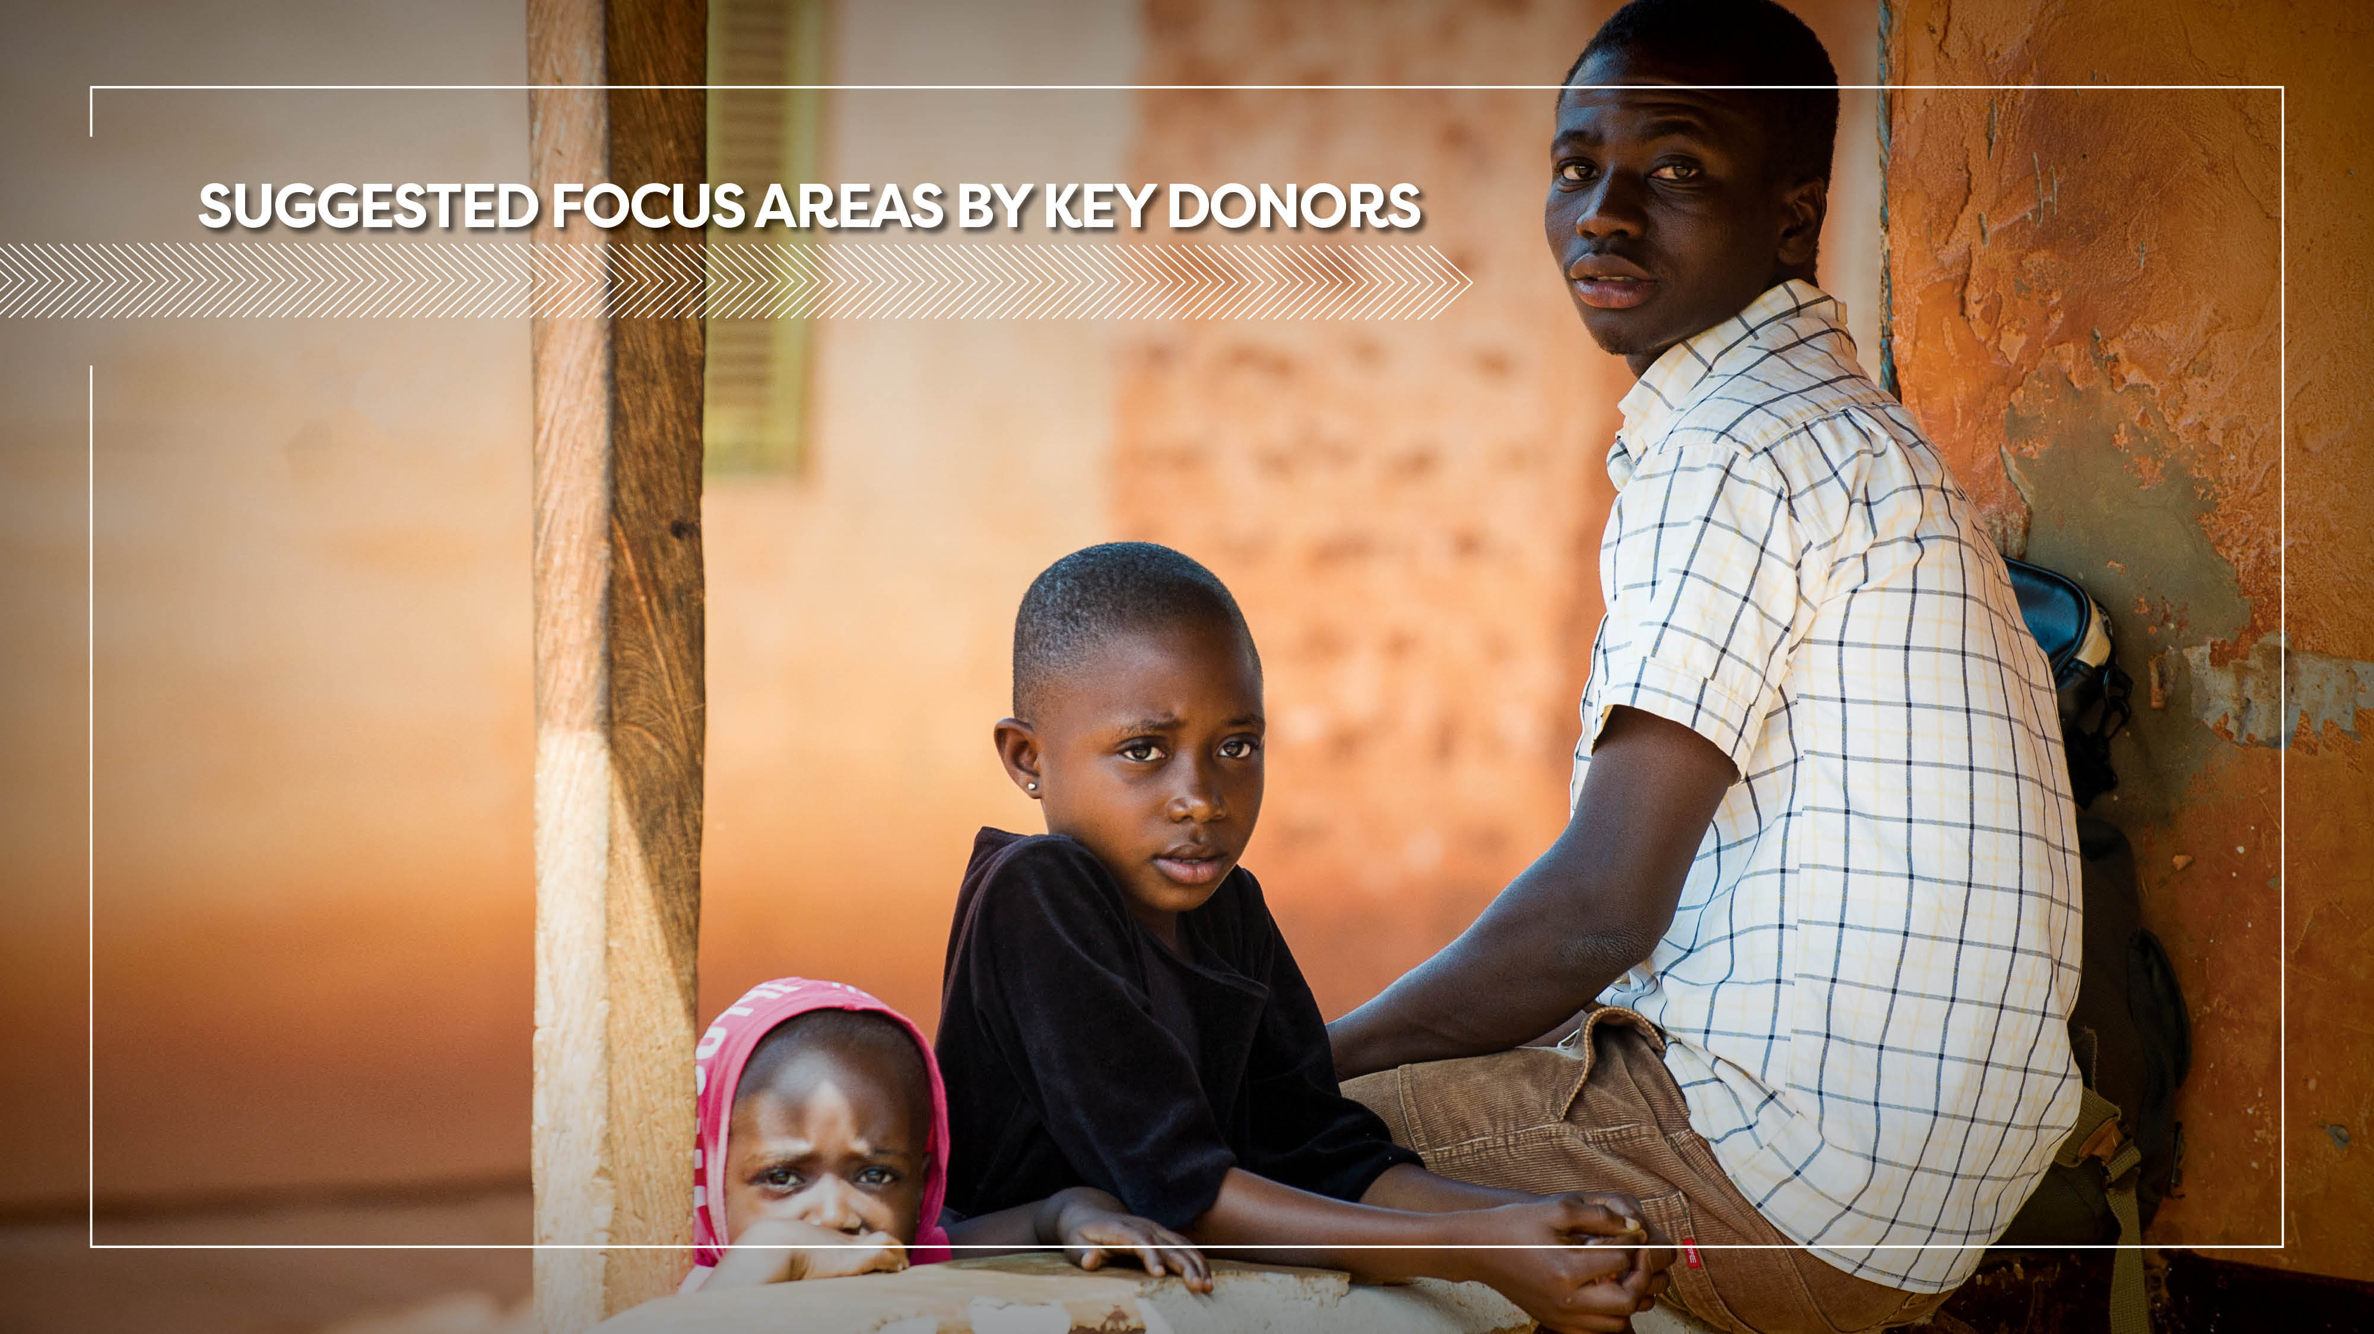

Slide 78
Do more in Stewardship
Stewardship |  | BMGF | USAID | GFATM | UNFPA | UNAIDS
1.1 | Require Governments to develop a vision for healthy condom programming that aims for growth, equity and sustainability. | X | X | X | X | X
1.2 | Stipulate in all investments that Governments increase their share of domestic financing for condom procurement. | X | X | X | X | X
1.3 | Reduce support for one-off condom procurement requests that do not include corrections of market failures. |  | X | X | X
1.4 | Continue and increase support for national leadership through Condom Working Groups (or similar national forum). |  |  |  | X | X
1.5 | Support market facilitator efforts to improve enabling environment. |  | X |  | X | X
1.6 | Help improve donor coordination. | X

Slide 79
Do more in Market Development
Market Development |  | BMGF | USAID | GFATM | UNFPA | UNAIDS
2.1 | Ensure that all funding requests are based on market assessments and identification of current market failures. | X | X | X | X | X
2.2 | Balance funding requests for commodity procurements with investment in demand creation. |  | X | X | X
2.3 | Redirect investments to ensure condom subsidy is targeted towards priority populations and last-mile efforts ONLY. |  | X | X | X
2.4 | Require rapid transition of condom programs that target the general population to full cost-recovery. |  | X | X | X
2.5 | Continue investments in the roll-out of the Condom Fast-track Tool to determine total condom needs and gaps across all countries. |  |  |  |  | X
2.6 | Support the development and use of other market analytics for evidence-based programming. | X | X
2.7 | Invest in the roll out of the Condom Dashboard across countries, to develop baselines and track progress over time. | X | X

Slide 80
Do more in Market Management
Market Management |  | BMGF | USAID | GFATM | UNFPA | UNAIDS
3.1 | Require sustainability plans for all condom programming funding requests | X | X | X | X | X
3.2 | Require rapid transition of condom programs that target the general population to full cost-recovery. |  | X | X | X
3.3 | Ensure funding for social enterprises does not create unfair market conditions for commercial players. | X | X | X | X
3.4 | Explore avenues to directly fund local commercial players. |  | X
3.5 | Improve reach of condom programming (targeted distribution, condom specific SBCC programming) through improved integration into cascade of care and treatment programs. |  | X | X |  | X
3.6 | Ensure funding requests target subsidy towards priority populations and last-mile efforts. |  | X | X | X
3.7 | Advocate for increased funding for priority populations | X |  |  |  | X

Slide 81
Report prepared by Mann Global Health
and commissioned by the Bill & Melinda Gates Foundation.

