Slide 1
You Can’t Manage
What You Can’t See
The Global Family Planning Visibility & Analytics Network
January 2021
Notes:
The Global Family Planning Visibility & Analytics Network (VAN) is a crucial resource in the effort to improve data visibility and inform robust reproductive health (RH) commodity supply chain management and decision-making.
This slide deck provides a general overview of the VAN and its evolution to date, how countries are using the platform to strengthen RH supply chains, the migration of the Procurement, Planning and Monitoring Report (PPMR) to the VAN, and how to join the network as a Basic Viewer.
Countries previously contributing data to the PPMR will find these slides a useful accompaniment to the related factsheet on the transition [copy and paste in your browser]: https://bit.ly/2Yf7Ji6

Slide 2
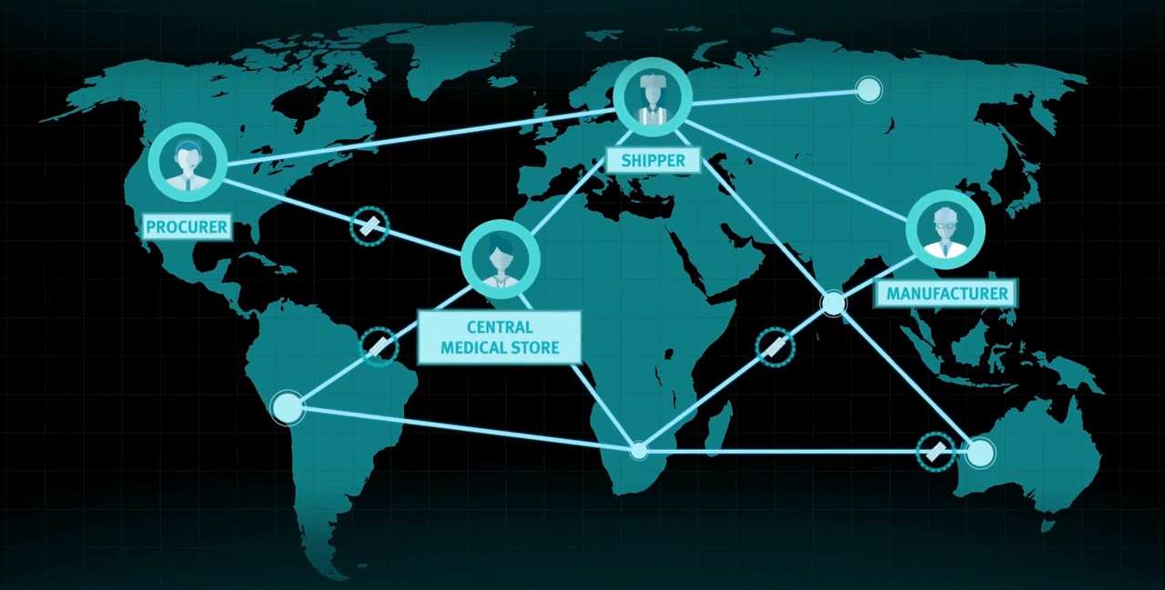
Notes:
[Accompanying video for this introductory information can be found here: https://youtu.be/OlG9dLyOW7E. If presenting, consider playing the video at this point in the presentation.]
In the face of shrinking development resources, reaching the unmet contraceptive need of millions of women will require more effective and efficient family planning (FP) supply chains. Getting there depends on improving supply chain visibility.
Strengthening this visibility is hard. The FP commodity supply chain is a complex ecosystem of trading partners spread across the globe and includes:
Procurers, including both country government and donors,
Manufacturers,
Shippers, and
Country governments.
At every stage of a product’s journey through this ecosystem, from one trading partner to the next, decision-makers need to see where the products are to answer key questions, like:
how many units of each do I need to buy, and for whom;
how much do I need to manufacture, and by when;
which products am I shipping to and where; and
when will my products arrive?
Insufficient, incorrect or mislabeled data will send inaccurate messages through the supply chain--resulting in stockouts, overstocks, expiration, wastage, and, ultimately, clients with empty hands.

Slide 3
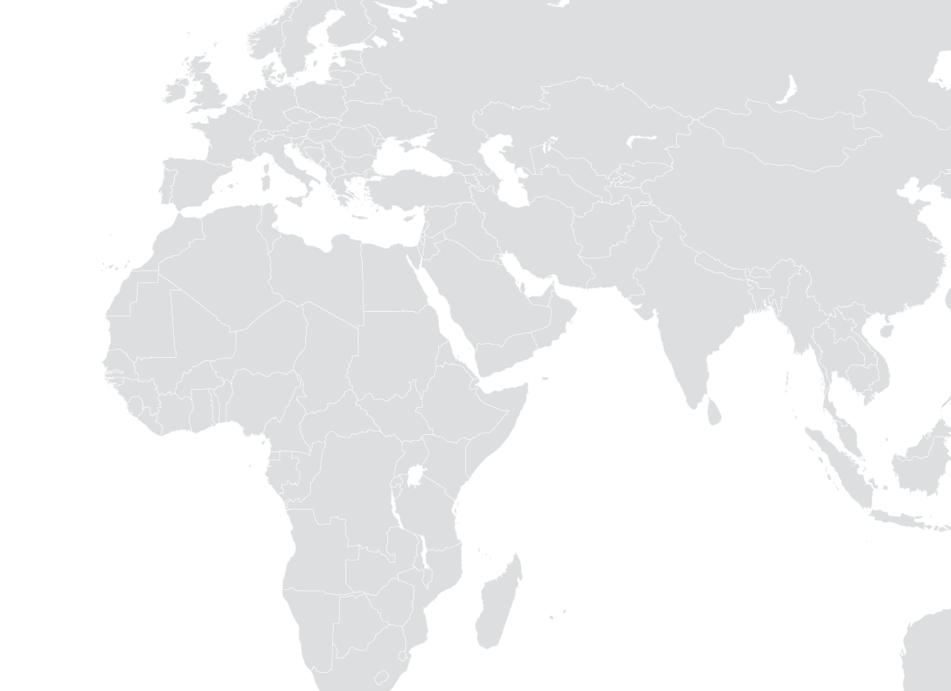








The Global FP VAN and countries
MANUFACTURERS AND SUPPLIERS
SHIPPERS
PORTS AND CUSTOMS
CENTRAL MEDICAL STORE
REGIONAL WAREHOUSE
HEALTH FACILITY / HOSPITAL CLINIC
CLIENT
Notes:
True visibility into the FP supply chain requires linking global and country actors so all are able to access the same information, enabling more robust decision-making. The foundation of this link is data—data is what allows supply chain players to “see” products all the way to the last mile, and data standards ensure each player has access to the same accurate information.
The VAN aims to resolve supply chain inaccuracies by allowing the right supply chain players to see the right data at the right time, helping them answer their questions and make decisions.
Countries are at the heart of the RH supplies ecosystem and thus, the VAN. They are where inbound products from manufacturers and shippers feed into in-country distribution all the way down to the last mile. The VAN helps connect countries to their global trading partners, and vice versa, with the aim of improving the effectiveness of RH supply chain management processes for all.

Slide 4
What is the Global FP VAN?
Notes:
This section provides a brief overview of the VAN.

Slide 5
The Global Family Planning Visibility & Analytics Network (VAN)
The VAN is a supply chain data visibility platform where the reproductive health supplies community can:
Assess
supply needs
Prioritize
those needs
Take action when supply imbalances loom.
Notes:
The VAN helps its members understand their data in the context of the broader global supply chain, providing visibility into each step along the way in ushering FP products from the manufacturer to the central medical store or distribution hub in country.
Members can utilize the VAN to:
Analyze their supply data against their supply needs.
Compare global order and shipment timelines to stock-on-hand data.
Prioritize supply needs based on the data analytics.
Alert partners of pending supply imbalances.
Coordinate with partners to take action and mitigate pending concerns.

Slide 6

Reproductive Health Supplies Coalition (RHSC)
The Reproductive Health Supplies Coalition is the world’s largest network of reproductive health (RH) supplies organizations.
Formed in 2004, it is a partnership of 500 public entities, private corporations, and NGOs working so that everyone in low- and middle-income countries (LMICs) can access and use affordable, high-quality RH supplies.
Notes:
The VAN is a community initiative managed by the Reproductive Health Supplies Coalition (RHSC, or Coalition).
The RHSC is focused on enabling countries to ensure they can access and use affordable, high-quality RH supplies.
As a neutral convening partner, the Coalition brings the RH community together to identify and collaborate on innovative solutions to RH commodity concerns. More than 500 Coalition members (including many Ministries of Health) work together via various working groups and task forces to develop tools, share data, and facilitate informed decision-making.
In 2016, members of the RH community asked the Coalition to manage implementation of the VAN, knowing that the Coalition could leverage its successful track record, member commitment, and global visibility to create a transformative data network for RH supply chain management.The VAN is meant to bring together people, processes, policy, and technology to transform the way our community makes supply chain decisions. .

Slide 7

Leveraging data visibility to increase access to reproductive health supplies
Members of the VAN can see further into their reproductive health commodities portfolio than ever before.
Over time, use of the platform should facilitate:
More timely and cost-effective delivery of commodities to countries,
More women and men reached with the right product at the right time, and
Better coordination in allocating limited health resources, crafting strategic plans, and resolving issues.
Notes:
The VAN offers members access to information like never before. Data from multiple trading partners is available in one platform, enabling members to more efficiently collaborate, better understand the condition of their supply chain, and rapidly resolve problems.
Beyond the data visibility and analytics, members also have access to technical assistance from VAN Analysts, and importantly, the other members of the network. Establishment of a partner network within the VAN will help trading partners realize increased efficiencies as they can more easily communicate with one another and share data, concerns, and successes.

Slide 8
Collaboration through the VAN
Notes:
This section provides more detail on how the VAN helps members work better together.

Slide 9
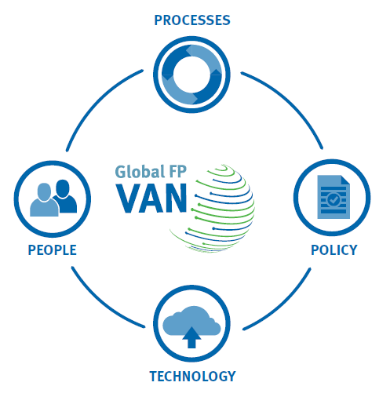
WHAT WE DO
VAN Goal
Better aggregate, share, and align country demand data with production, procurement and funding to avoid stock imbalances and maximize use of limited resources to ensure continuous availability and choice of family planning products in developing countries.
Better = technology
Aggregate = process
Share = policy
Align = people
Notes:
While it can be easy to think of the VAN as just another tool or system, it goes beyond that. The VAN is not just a technology fix, rather, technology is there to empower the people and processes and facilitate alignment among members.
As described in the slide, the words of the VAN goal align to each of the four quadrants of the VAN conceptual framework (graphic on the right).
Doing things better/easier is where the technology part comes in.
Aggregating data is where we need processes around data management.
Sharing is where policy comes in, especially around data sharing.
Aligning is the important work of linking the people that are the supply chain actors who make up the network of the VAN.

Slide 10

Facilitate efficient connections
WHAT WE DO
Many connect to many
Many connect through one
SUPPLIER A
COUNTRY A
SUPPLIER A
COUNTRY A
SUPPLIER B
COUNTRY B
SUPPLIER B
COUNTRY B
SUPPLIER C
COUNTRY C
SUPPLIER C
COUNTRY C
Notes:
Before the VAN (on the left), trading partners established their own singular connections with one another, everyone connecting to everyone else independently with limited visibility between these connections and limited collaborative decision-making.
With the VAN (on the right), the vision is that supply chain players will connect via a robust, virtual platform (i.e., the VAN) where they see the same data, enabling them to make supply chain decisions together.

Slide 11


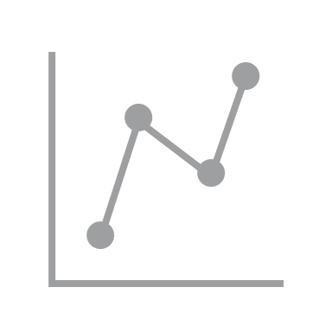

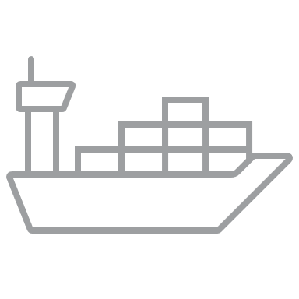

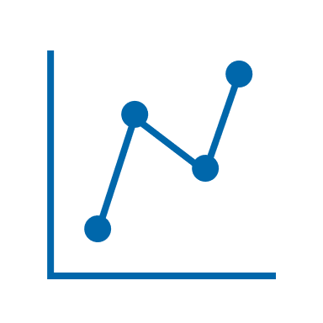

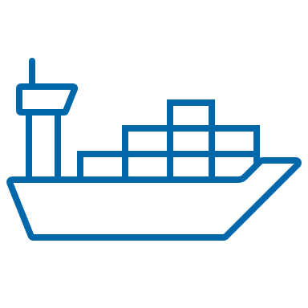


WHAT WE DO
Unify tools and processes
Past
Present and Future
FORECASTING
PROCUREMENT
& ORDERS
SHIPMENT
CONSUMPTION & STOCK
FORECASTING
PROCUREMENT
& ORDERS
SHIPMENT
CONSUMPTION & STOCK
RH Interchange
GLOBAL FP VAN
CARhs work stream
PPMR
CSP work stream and CSP Tool
Notes:
In addition to bringing trading partners together to realize efficiencies in collaboration and decision-making, the VAN also merges previously siloed tools and processes into one platform, making data entry and analysis more accurate and efficient.
Historically, the Reproductive Health Interchange (RHI) was developed to tell us who had purchased commodities and how much they bought. The PPMR gave us information on country stock levels. The Coordinated Assistance for Reproductive Health Supplies (CARhs) group and Coordinated Supply Planning (CSP) group worked with countries to respond to or proactively prevent in-country stock imbalances.
While these tools and processes helped supply partners understand the environment, they didn’t provide a comprehensive view. The technology was becoming outdated, systems were often siloed and duplicative, data standards were lacking, and the range of trading partners were becoming increasingly complex.
To facilitate easier interaction between trading partners and allow for a more holistic view of supply data, the community called for a singular effort that would migrate previous processes and tools onto a more robust, virtual, collaborative platform where supply chain players could see data and make supply chain decisions together. The VAN was designed to meet this call.
The PPMR, flagged in the graphic above, is the last of these previous tools to migrate to the VAN platform.

Slide 12
Operationalizing the VAN: Progress to date
Notes:
This section provides information on current VAN membership, governance, and usage.

Slide 13
Sample of current member organizations
GOVERNMENTS
Ethiopia
Ghana
Malawi
Nigeria
DONORS AND PROCURERS
Bill & Melinda Gates Foundation
United Kingdom Foreign, Commonwealth & Development Office
United Nations Population Fund
United States Agency for International Development
West African Health Organization
TECHNICAL ASSISTANCE PARTNERS
Clinton Health Access Initiative
Global Health Supply Chain Program-Procurement and Supply Management project
Global Health Supply Chain Program-Technical Assistance Francophone Task Order
John Snow, Inc.
SUPPLIERS AND MANUFACTURERS
Mylan Laboratories, Ltd.
Shanghai Dahua Pharmaceutical Co., Ltd./DKT WomanCare
Global Services SAS
Notes:
The VAN is working closely with many organizations at the global and country levels. With over 140 individual users from 17 member institutions, the VAN has experienced significant growth since its launch in 2019. [Numbers current as of January 2021]
We are excited to add a number of new government partners to this list as the PPMR transition moves forward.

Slide 14



Central governance
Steering
Committee
Management Unit
Task Forces
8
Resolve conflicting priorities and handle escalations
Set direction
Define scope and approach
Steerco Member Orgs
Accept scope and approach
Manage project and implementation
Provide feedback and recommendations
17
Member Orgs
Provide technical input to design and implementation
Gather and refine requirements
+140
USERS: Process
Data Sharing: Policy
Data Mgmt: Structure
Tech Mgmt: System
Users
Notes:
The VAN has a robust governance structure to establish decision-making processes across a large spectrum of supply chain players, and a set of policies or norms to manage that decision-making.
Since the VAN is not a single organization, there must be a governance structure that allows for the necessary collaboration and facilitates buy-in from all participants. The VAN governance model, based on that of the RHSC, solicits community input and acts on their behalf, is neutral, and makes decisions across a large community of practice.
Examples of key decisions include things like deciding on the data standards to use in the platform, making policy decisions/recommendations for data use, and setting the overall scope and vision of the VAN.
Steering Committee members include BMGF, FCDO, UNFPA, USAID, RHSC, and user representatives from GHSC-PSM, GHSC-TA, and JSI (as of January 2021).
More information on the evolution of the VAN governance structure can be found in the recently published Governance Case Study on the VAN website: https://www.rhsupplies.org/uploads/tx_rhscpublications/GFPVAN-Case-Study-People.pdf

Slide 15
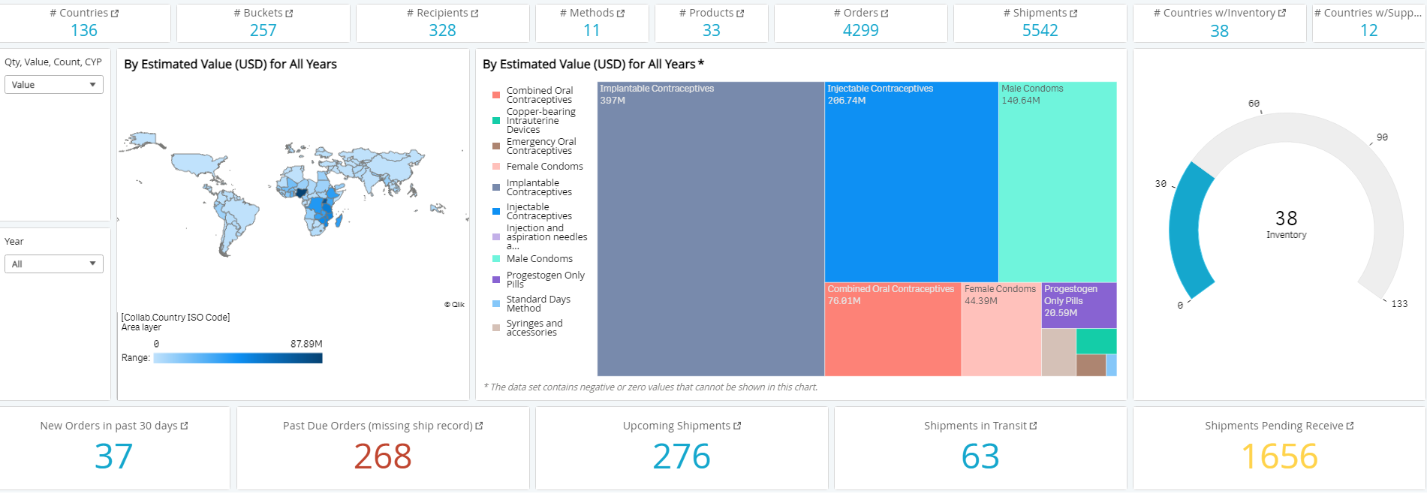
The VAN today: Statistics
Data updated 01/2021
Notes:
The VAN platform was launched in January 2019 and has become a significant data aggregator. Its power resides in being able to harmonize data descriptions, thereby integrating and aggregating supply chain inventory and order and shipment data from across many different organizations and entities into one platform.
This dashboard from the Analytics Platform shows that, as of January 2021, more than 140 users across 17 organizations can track 4,000 orders, and 5,000 shipments across 136 countries for 33 products.
This slide is a screenshot of a dashboard view available in the VAN and gives a sense of the volume and value of RH products moving through the supply ecosystem.

Slide 16
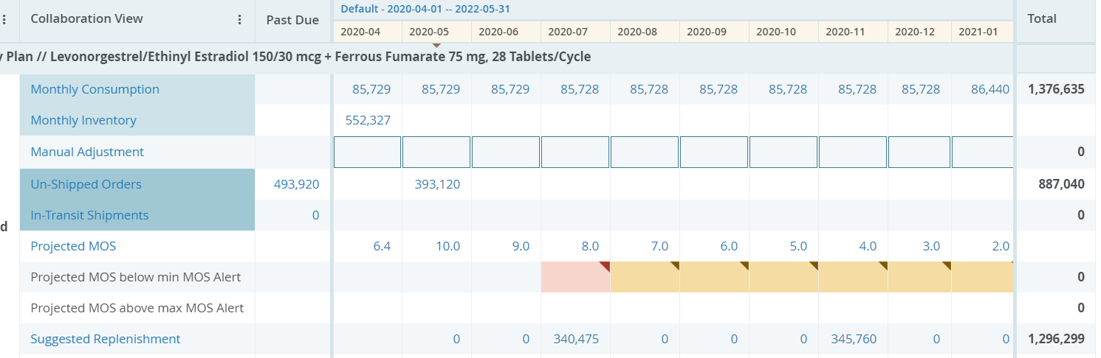
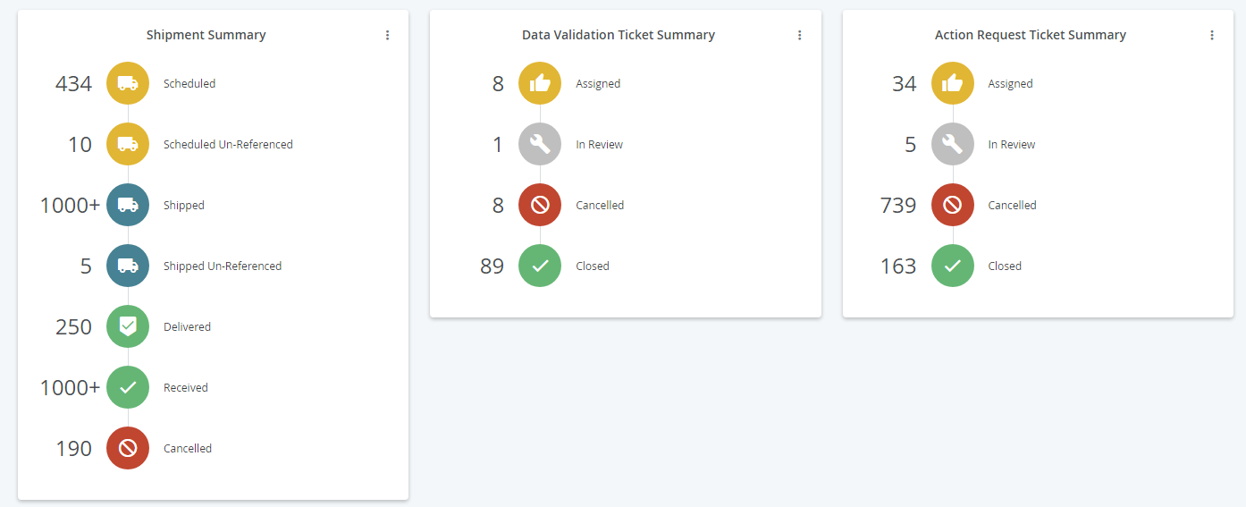
The VAN today: Decision-making
Consumption
Future orders
Projected Months of Stock
Most recent inventory
Notes:
The VAN has also become a key place for countries to have an easily accessible visual roll-up that tracks planned and incoming shipments against consumption and inventory, flagging product over- or under-stocks against the supply plan.
They can see the trend in consumption and stock-outs over time against their requests/orders, and they can use the scenario builder in the platform to plan out their future orders.
The slide here provides additional screenshots of how this data is visualized in the VAN and what members will see as they use the platform.

Slide 17


Examples of the VAN streamlining supply chain management practices
Malawi
The ability to monitor shipments from manufacturer to country helped them identify a critical shipment delay after Cyclone Idai. They were able to quickly redirect stock between facilities, avoiding stockouts.
Nigeria
Direct visibility into donor order and shipment data within one platform improved supply chain management efficiency, eliminating previous need to track down missing data via email and phone calls in order to complete reports.
Malawi
The VAN flagged over-forecasting of contraceptive implants, based on supply availability data. The forecast was properly adjusted, creating better efficiencies.
Nigeria
Availability of exact purchase order numbers facilitates more informed decision-making with local partners.
Notes:
The breadth of data VAN members can access and the way it is easily visualized for analysis and action, are working to facilitate more efficient RH supply chain management in countries.
This slide provides a summary of recent feedback from VAN member countries. It is evident there is an array of value to countries joining the VAN, with simplification of processes and increased efficiencies being key value drivers.

Slide 18
Becoming a member of the VAN
Notes:
This section provides information on how to join the VAN.

Slide 19

Entry point: Basic Viewer membership
In order to harmonize data sharing and analysis in one robust platform, the RH community is migrating the PPMR to the VAN platform. This will allow countries to share, access, and interact with their data and trading partners in one place.
With this transition, countries formerly participating in the PPMR will see:
Continued technical support formatting, reviewing, and validating inventory data,
Continued mechanism to communicate stock needs and requests to donors and global partners to avoid stockouts,
Ability to track orders and shipments coming into the country, in near real-time, mapped against the country’s inventory and consumption data, and
Access to country-specific dashboards, automatically updated with new data.
NEW
NEW
Notes:
The VAN offers members access to information like never before. Data from multiple trading partners is available in one platform, enabling members to more efficiently collaborate, better understand the condition of their supply chain, and rapidly resolve problems.
Beyond the data visibility and analytics, members also have access to technical assistance from VAN Analysts, and importantly, the other members of the network. Establishment of a partner network within the VAN will help trading partners realize increased efficiencies as they can more easily communicate with one another and share data, concerns, and successes.

Slide 20

I’m interested in membership, what do I do next?
Contact Greg Davidson, Supply Chain Officer, Global FP VAN, gdavidson@rhsupplies.org
Identify local users of the platform collaborating with relevant local and global partners.
Ensure those local users of the platform join a VAN orientation webinar.
Log in and accept the VAN Terms of Use (TOU).
A publicly available example of the VAN TOU is available here: https://bit.ly/3ciA1kl
Continue sharing supply data, using the same PPMR form as before
Note: No process changes are required regarding how you share data. The data you submit will automatically route into the VAN for analysis in the platform.
Log into the VAN regularly to utilize the host of data and features available.
Notes:
Joining the VAN is a straightforward process.
Countries should notify the VAN Management Unit of their interest, which will move the process forward.
A key step is identifying local representatives who will be the primary users of the VAN. This can include individuals from the government, as well as other in-country supply chain actors that would need access to the VAN to ensure local collaborators are equally informed. The PPMR data provider should be one of the individuals and can assist in identifying other potential users.
A representative of the government should log in and accept the VAN TOU and Data Sharing Rights Table. This is required to access the platform.

Slide 21



For more information
Greg Davidson, Supply Chain Officer: gdavidson@rhsupplies.org
VAN Factsheet - PPMR Transition: https://bit.ly/2Yf7Ji6
RHSC Global FP VAN website: https://www.rhsupplies.org/gfpvan

